Slide 1
Ancient Egypt in Video Games: Reconstruction and Simulation in Assassin’s Creed: Origins and Total War: Pharaoh: New Technologies in the Digital Reception of the Past
Mladen Tomorad
Department of History, Faculty of Croatian Studies, University of zagreb

Slide 2
Introduction: Archaeogaming and the Digital Reception of Ancient Egypt
Video games as a major contemporary medium for the perception and reception of ancient history
Archaeogaming: the study of how the past is represented, reconstructed, and simulated in digital interactive environments
Games now shape public understanding of Ancient Egypt more strongly than film, television, or textbooks
Digital reconstructions enable experiential engagement with ancient landscapes, architecture, and daily life
Interactive media provide new ways to visualize urbanism, ritual practice, environmental settings, and social structures

Slide 3
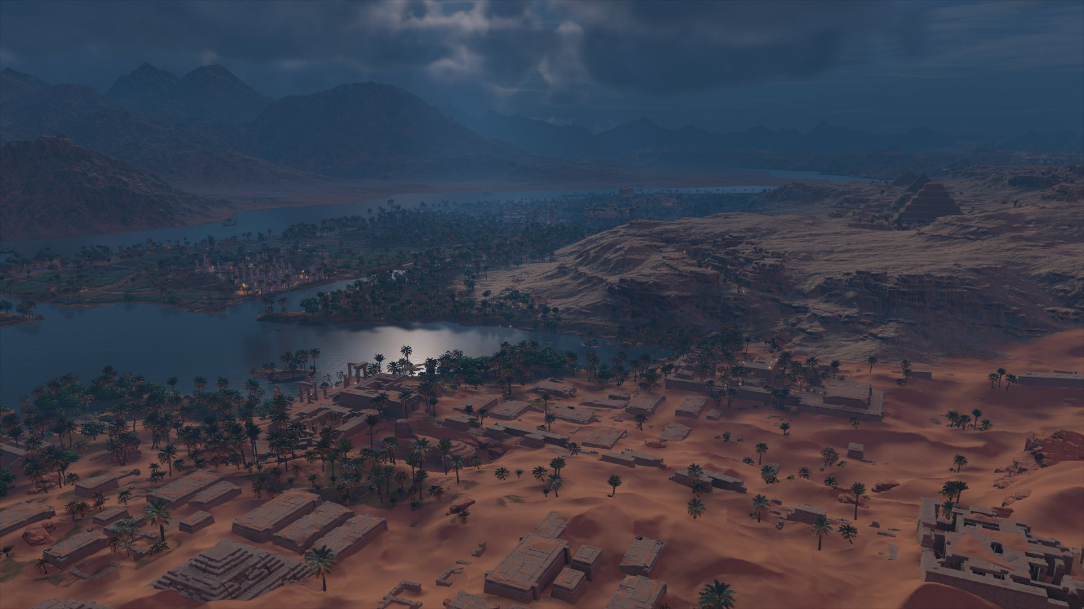
Educational potential: from “living museum” models to university‑level teaching and public outreach
The need for critical analysis of digital representations (accuracy, stereotypes, narrative simplifications)

Slide 4
Assassin’s Creed: Origions (2017) – A Digital „Time Machine”
Action RPG published by Ubisoft (2017)
Set during the civil war between Cleopatra VII and Ptolemy XIII (49–47 BC)
Player controls Bayek, a Medjay protector, and Aya, predecessor of the “Hidden Ones”
Narrative integrates major historical events:
  Caesar–Pompey conflict,
  Alexandrian War,
  political crisis of the late Ptolemaic Kingdom
Two DLCs (Sinai and Thebes, 40–30 BC) expand the world with fictional but historically inspired storylines

Slide 5
High‑quality reconstruction of architecture, landscapes, daily life, and religious practices in late Ptolemaic Egypt
Combines historical accuracy with creative reinterpretation of history
One of the most visually detailed and culturally rich depictions of Ancient Egypt in modern gaming
Immersive experience of ancient landscapes, cities, and architecture
Phenomenological approach: “walking through” ancient spaces
Clear distinction between Egyptian and Hellenistic architectural and cultural spheres
Developed using archaeological models and historical consultancy

Slide 6
Visual Reconstruction of Ptolemaic Egypt
Large‑scale reconstruction of major Egyptian landscapes and monuments
Pyramids and various necropolis around Memphite region rendered with high archaeological fidelity
Memphis shown as a monumental, densely populated urban centre
Alexandria reconstructed as a Hellenistic metropolis: Library, Serapeum, Pharos
Visual distinction between Egyptian and Greek architectural traditions
Enables experiential engagement with ancient spaces through exploration

Slide 7
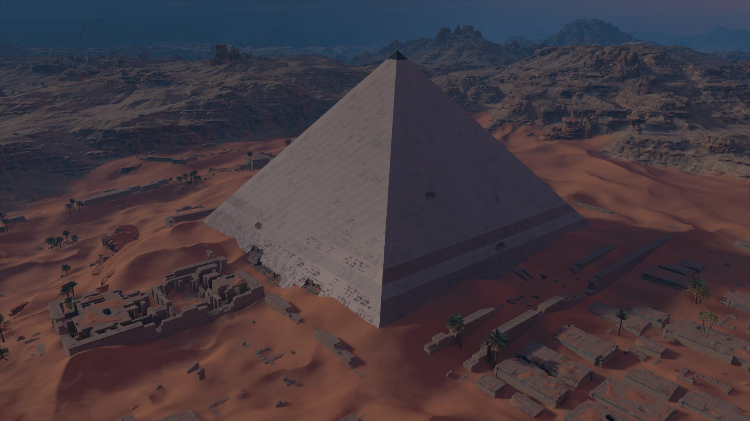

Slide 8
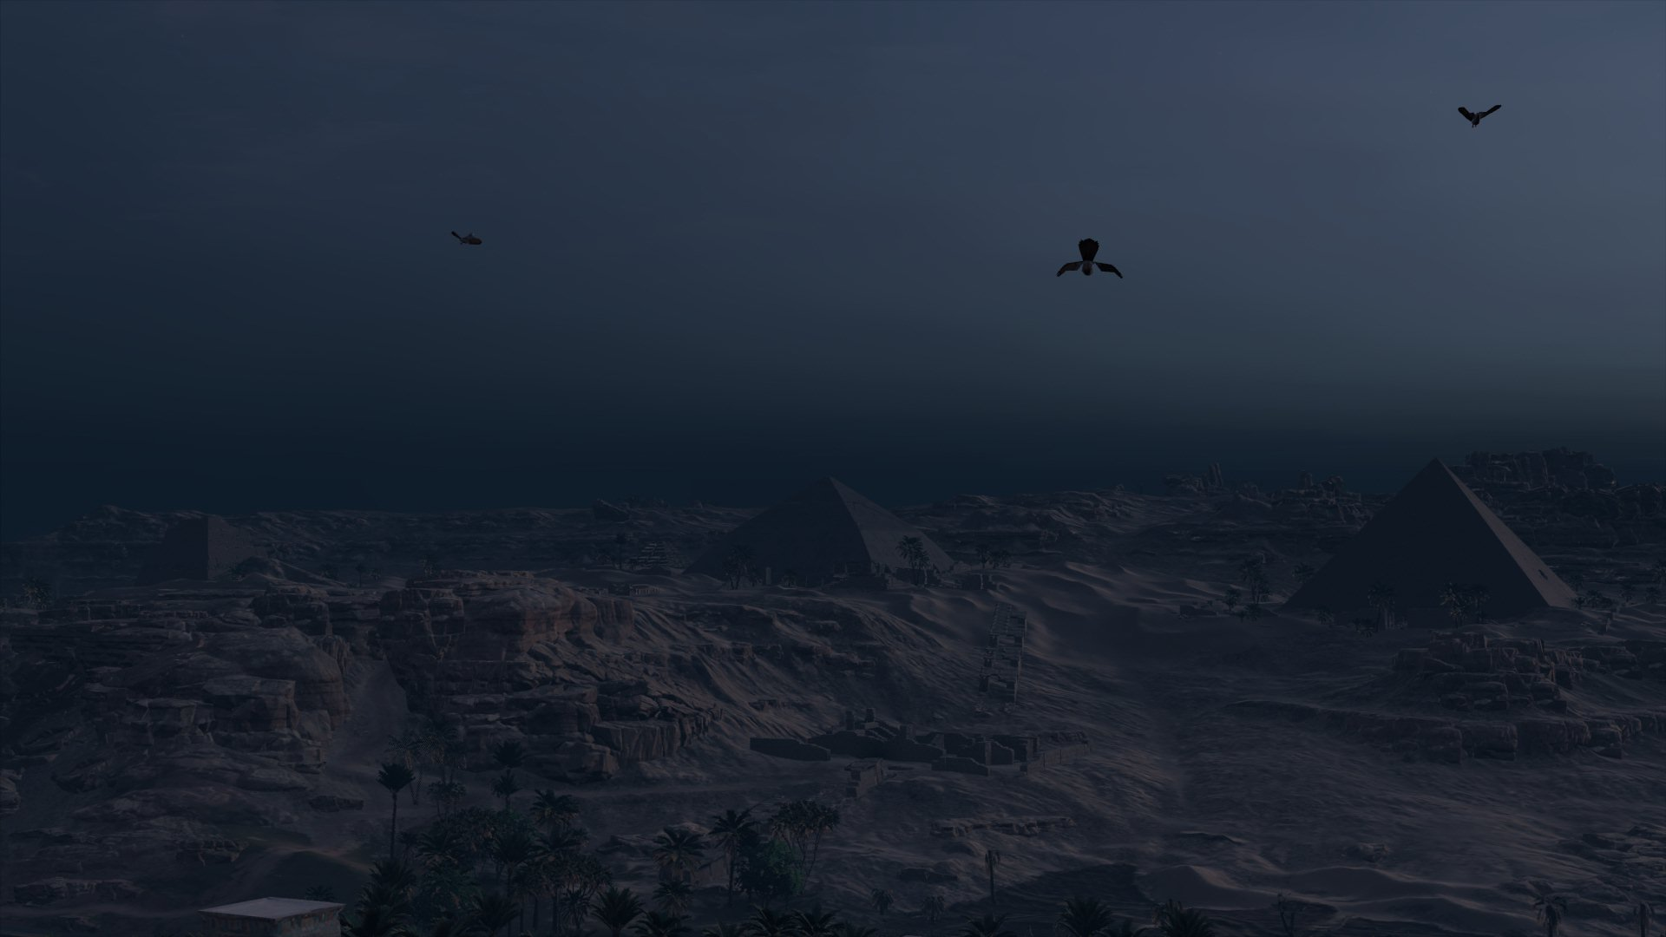

Slide 9
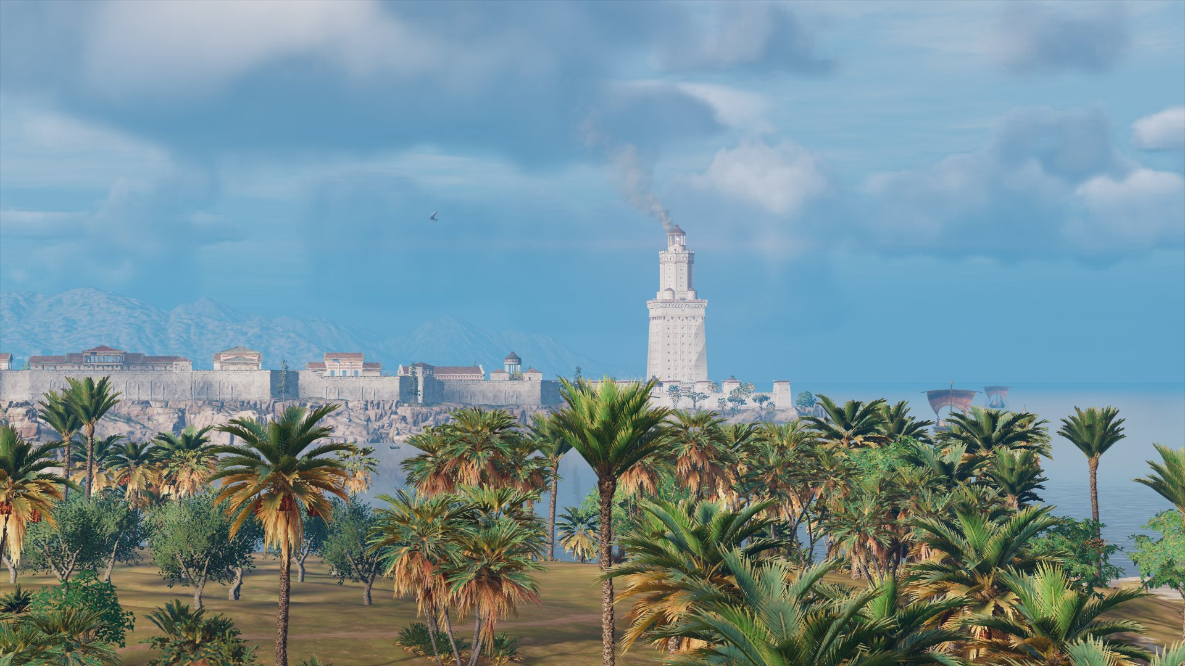

Slide 10
Interior and Urban Space
Detailed reconstruction of interior spaces, including tombs, shrines, and domestic architecture
Fictionalized but archaeologically inspired tomb of Alexander the Great as a major narrative and visual element
Urban houses show multi‑storey Hellenistic domestic architecture with workshops, courtyards, and storage areas
Interiors emphasize material culture: furniture, wall decoration, lighting, ritual objects
Enhances immersion by allowing players to explore everyday environments, not only monumental sites
Demonstrates how digital media visualize spaces rarely preserved in the archaeological record

Slide 11
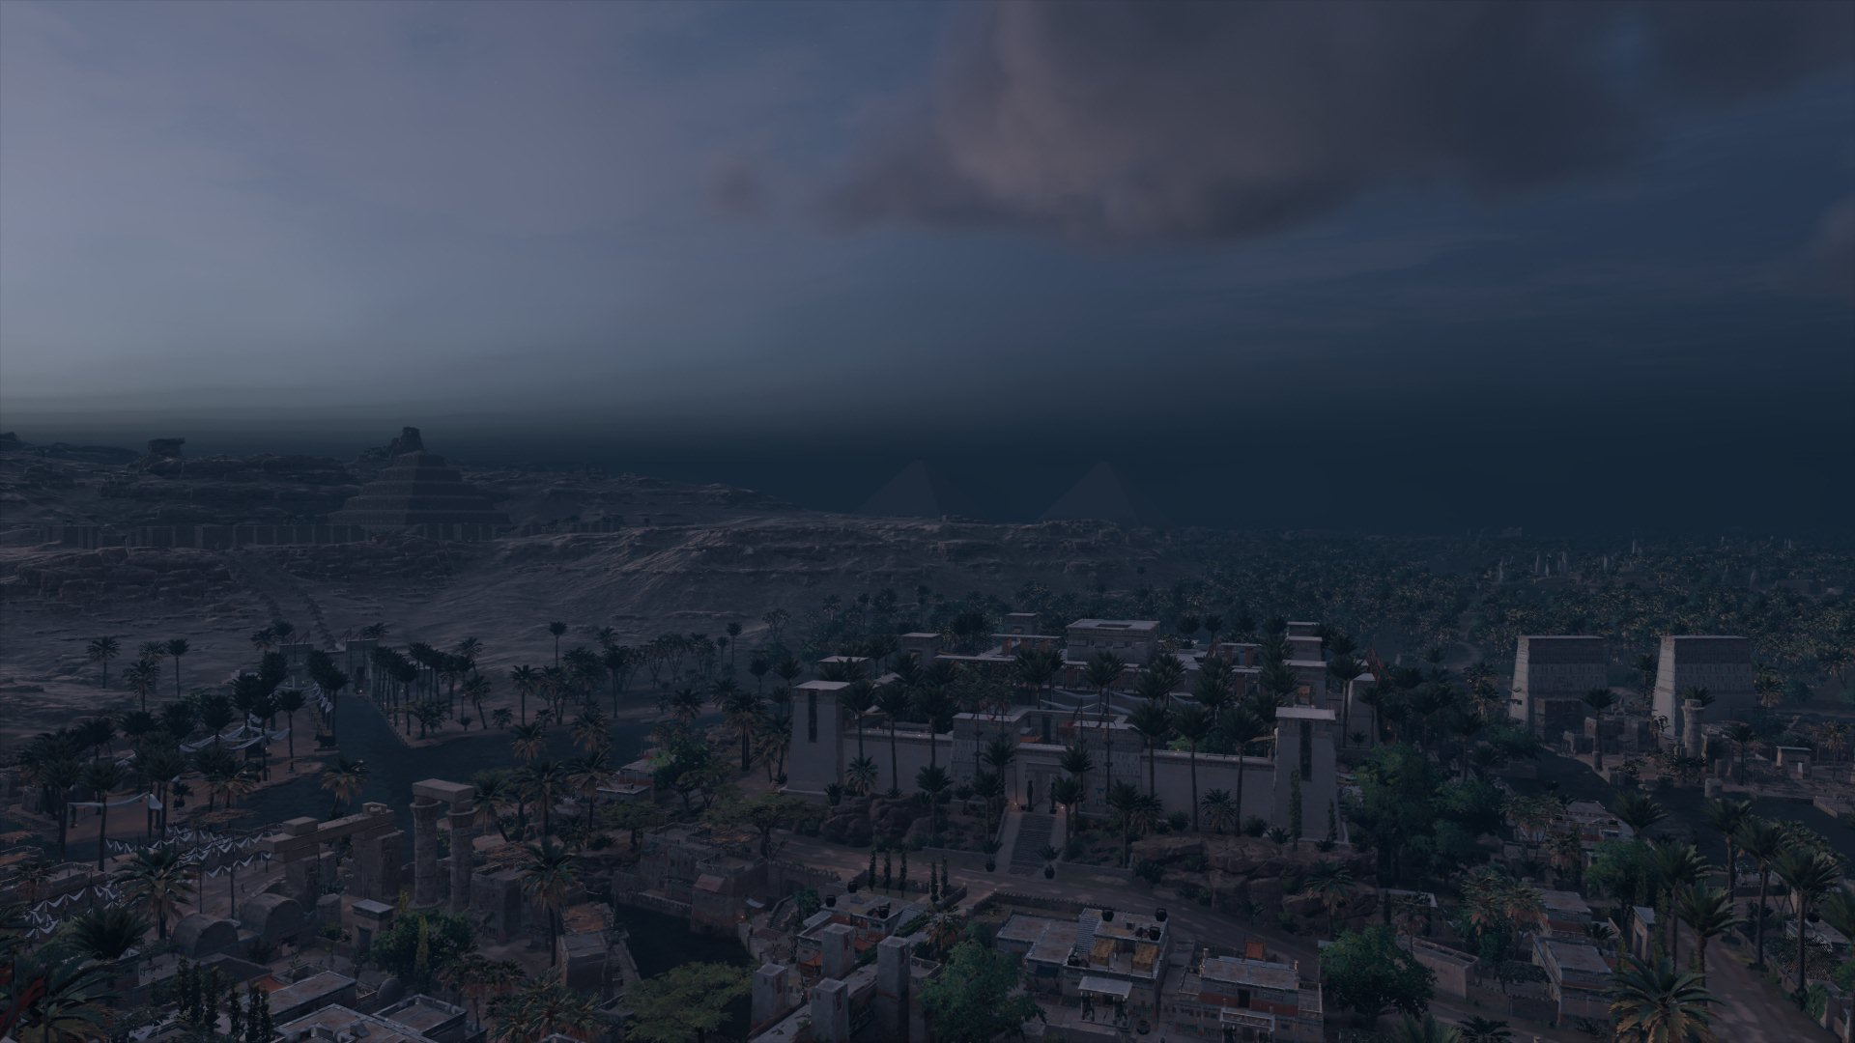

Slide 12
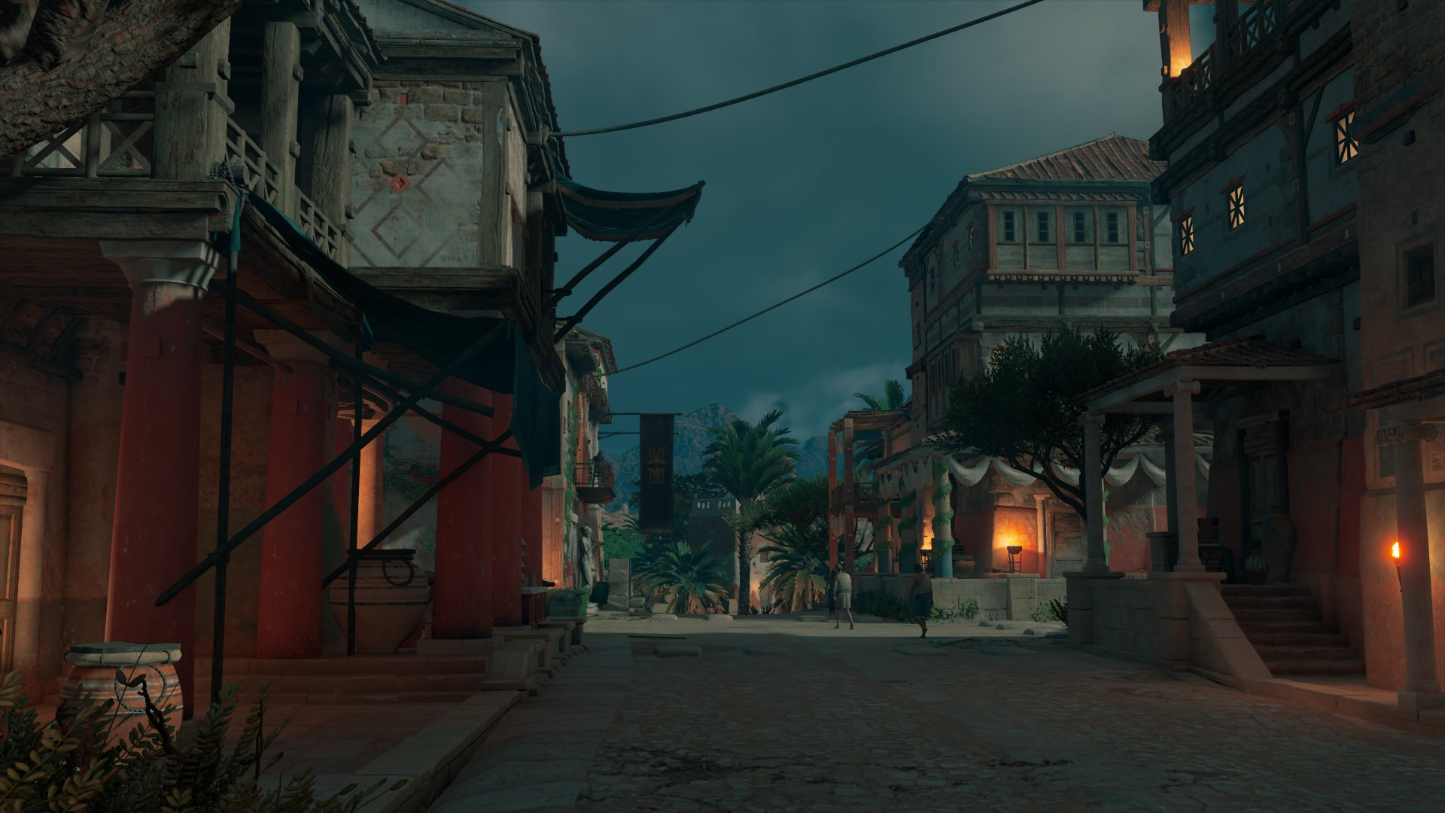

Slide 13
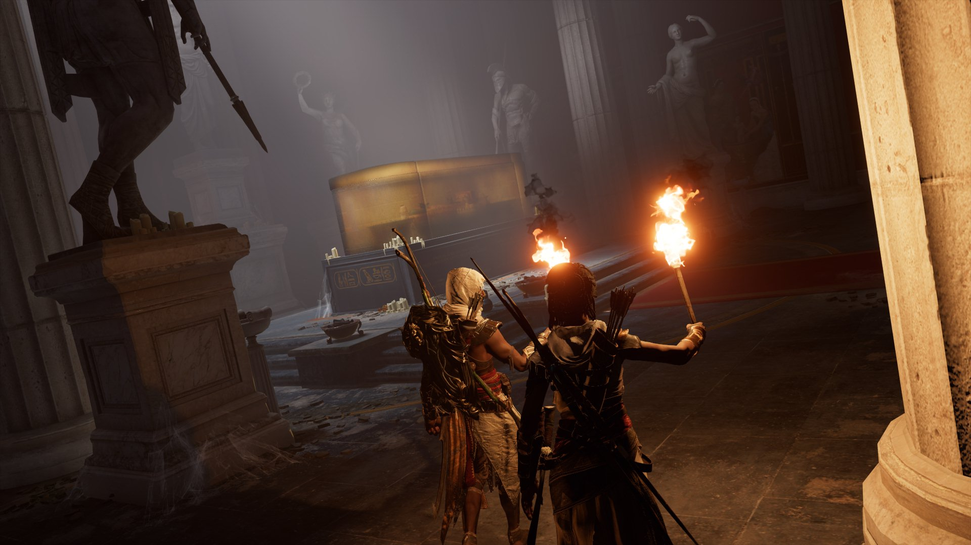

Slide 14
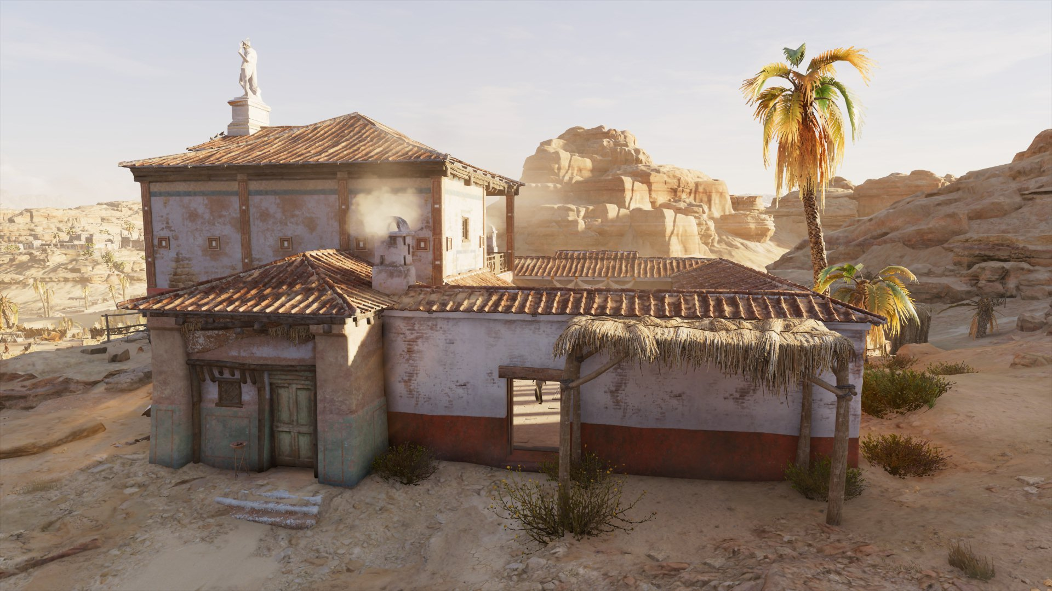

Slide 15
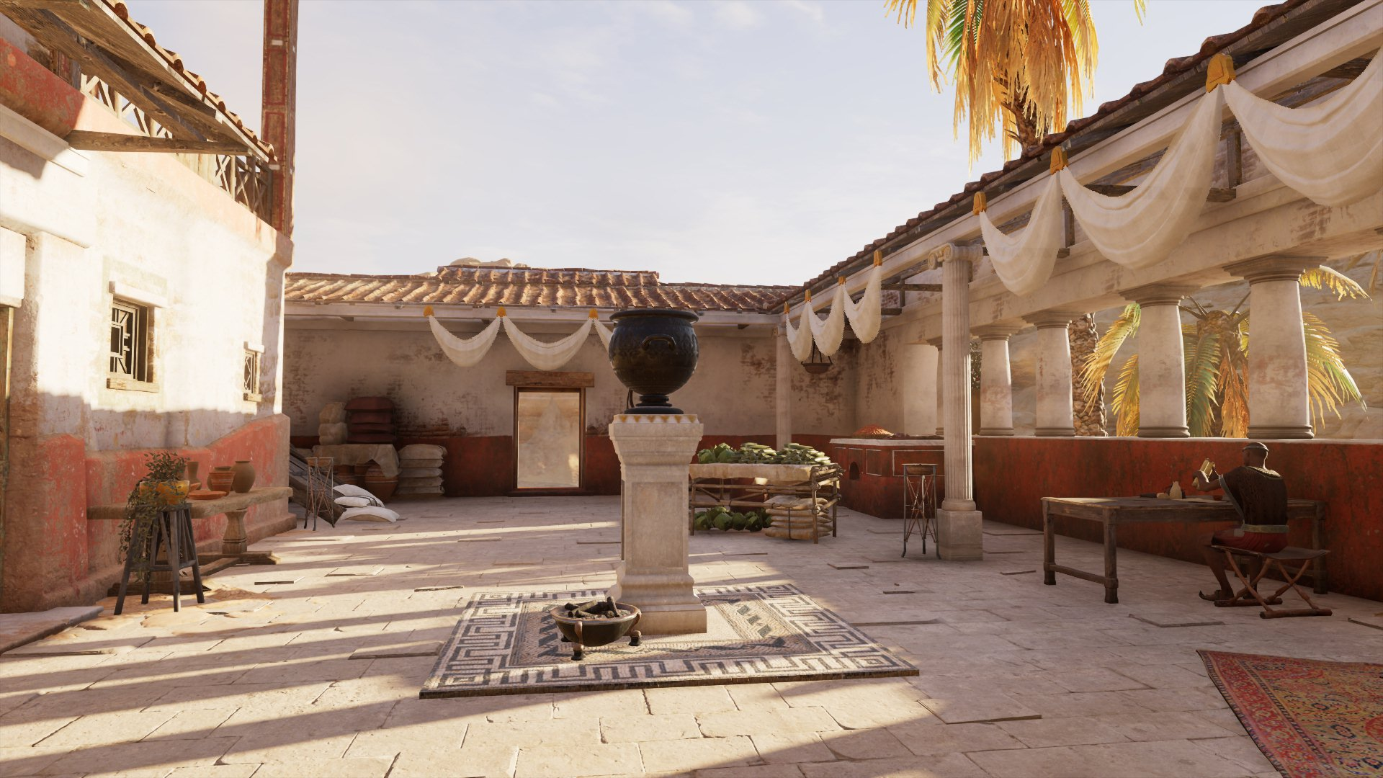

Slide 16
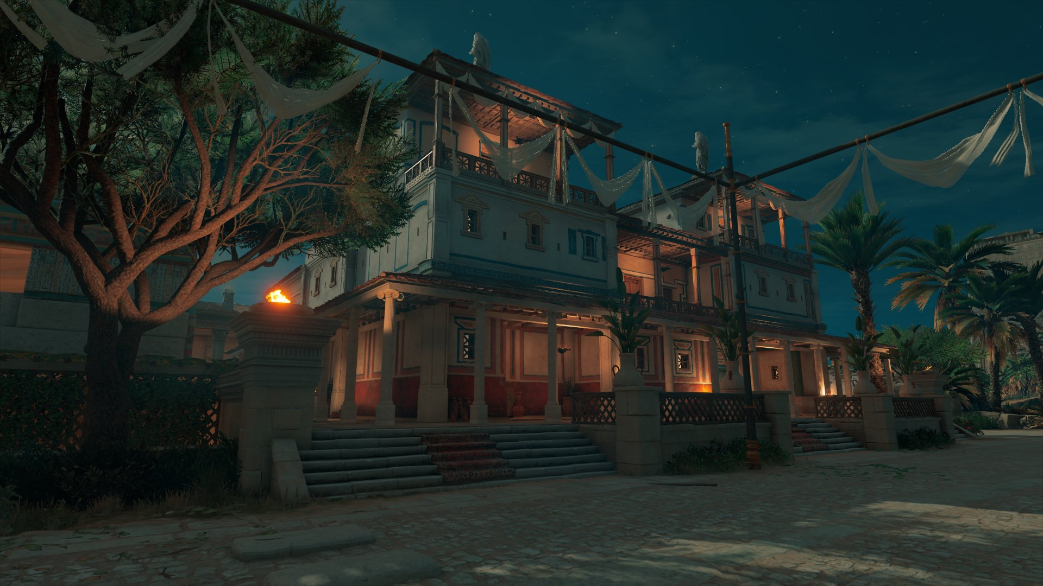

Slide 17
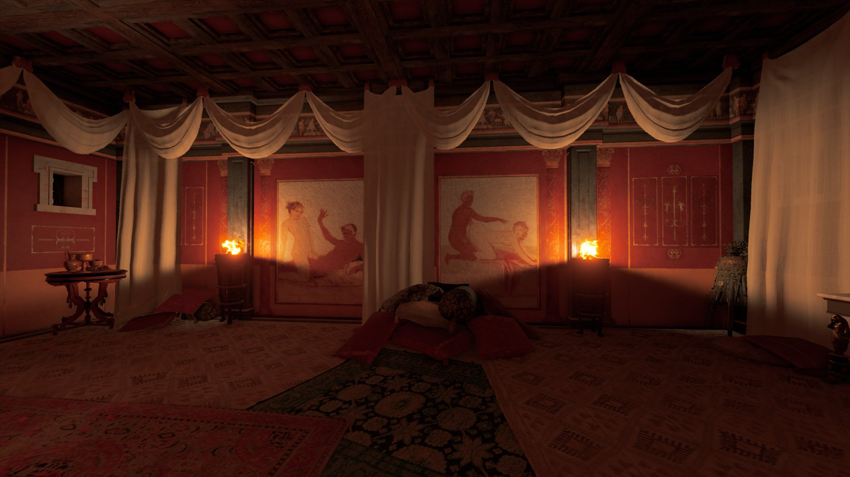

Slide 18
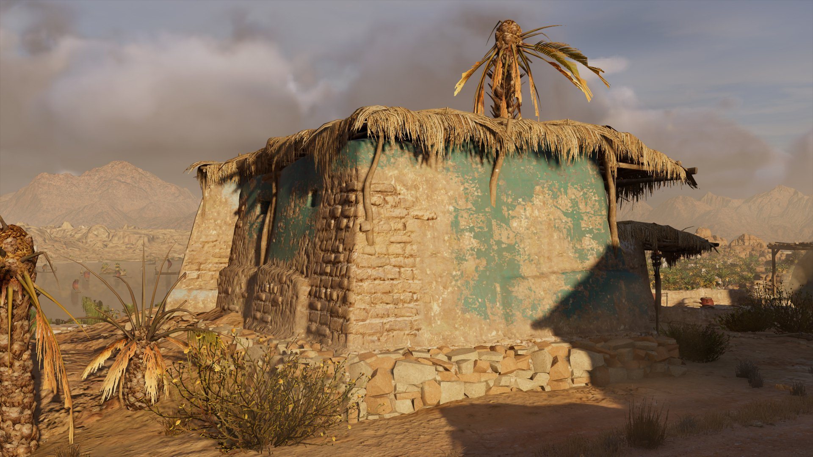

Slide 19
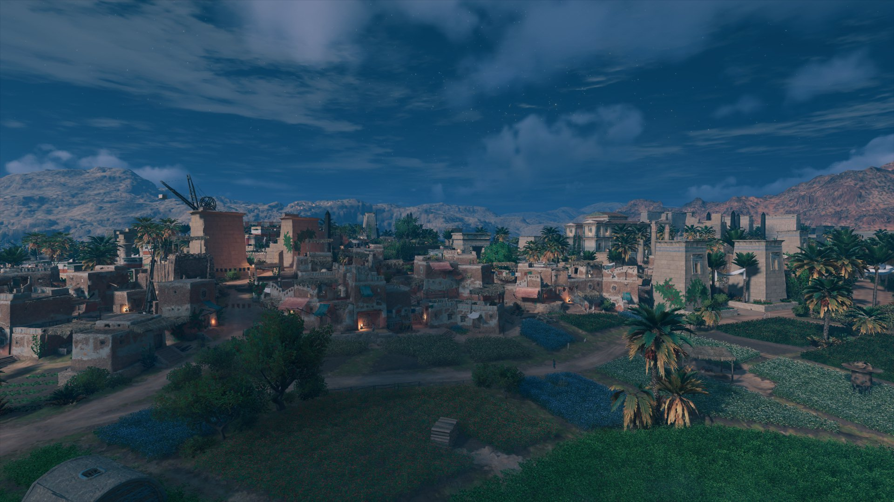

Slide 20
Archaeological Monuments and Sacred Spaces
Detailed reconstruction of major temple complexes (Karnak, Luxor, Serapeum, Isis temples)
High‑fidelity rendering of necropolis architecture: Saqqara, Giza, Valley of the Kings
Interior spaces inspired by archaeological evidence:
  – decorated burial chambers
  – ritual rooms
  – offering chapels
Thebes DLC expands sacred landscapes with fictionalized but research‑based reconstructions
Emphasis on ritual topography: processional routes, pylons, courtyards, hypostyle halls
Visualizes architectural elements rarely preserved today
Bridges monumental architecture with religious practice and cultural memory

Slide 21
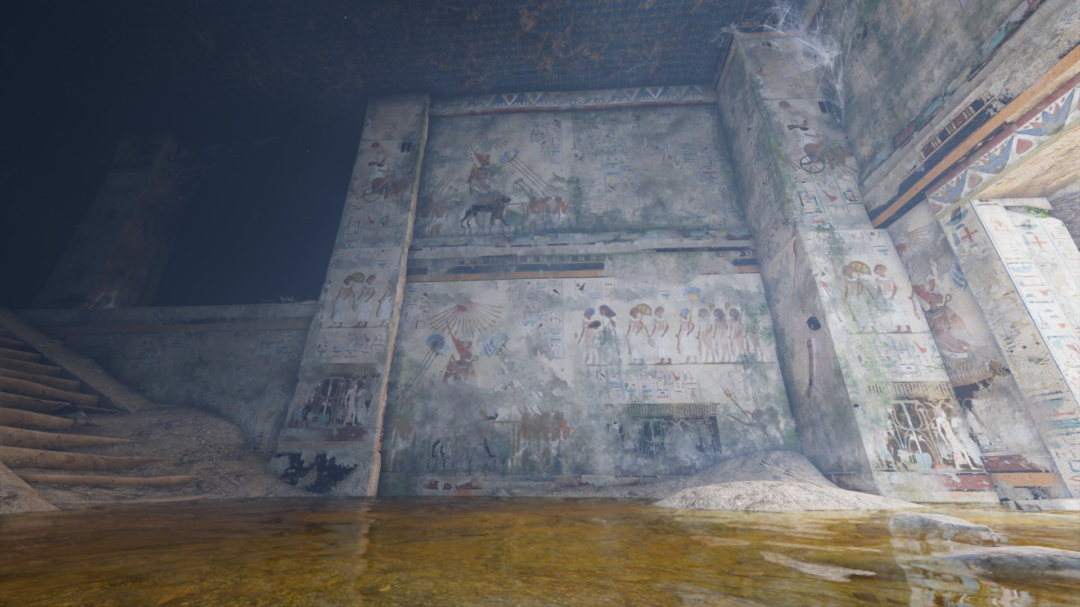

Slide 22
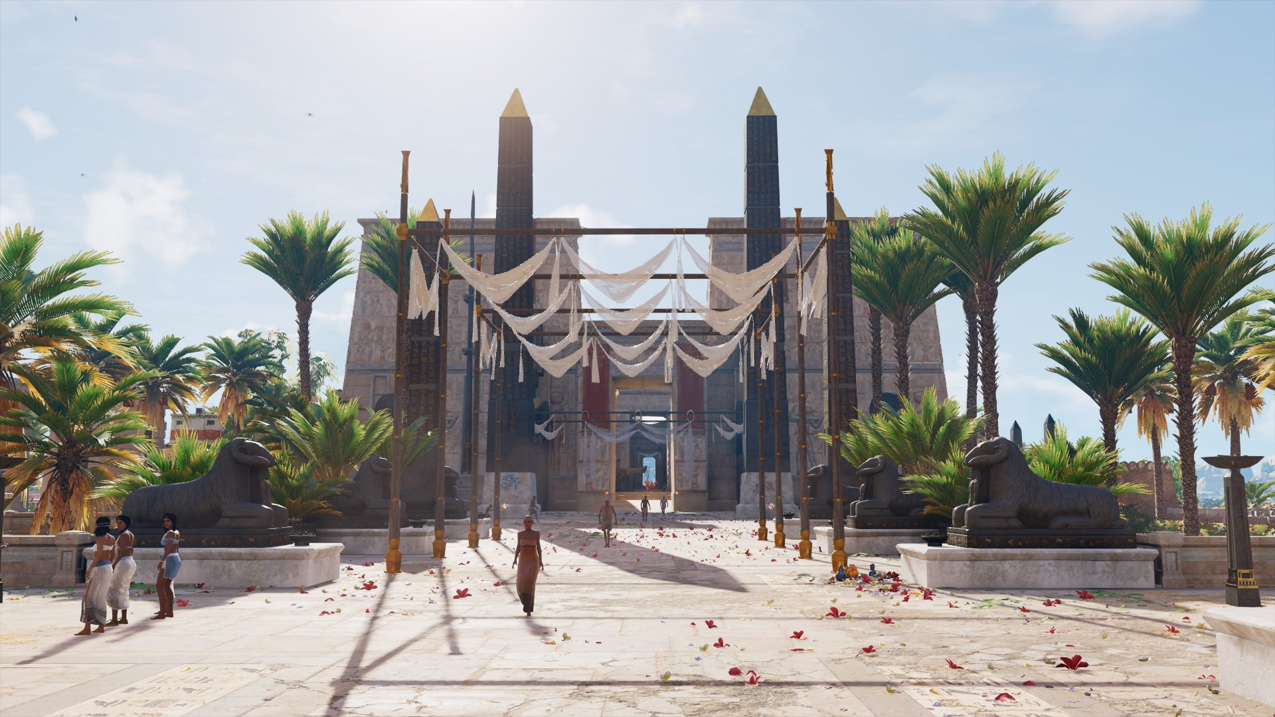

Slide 23
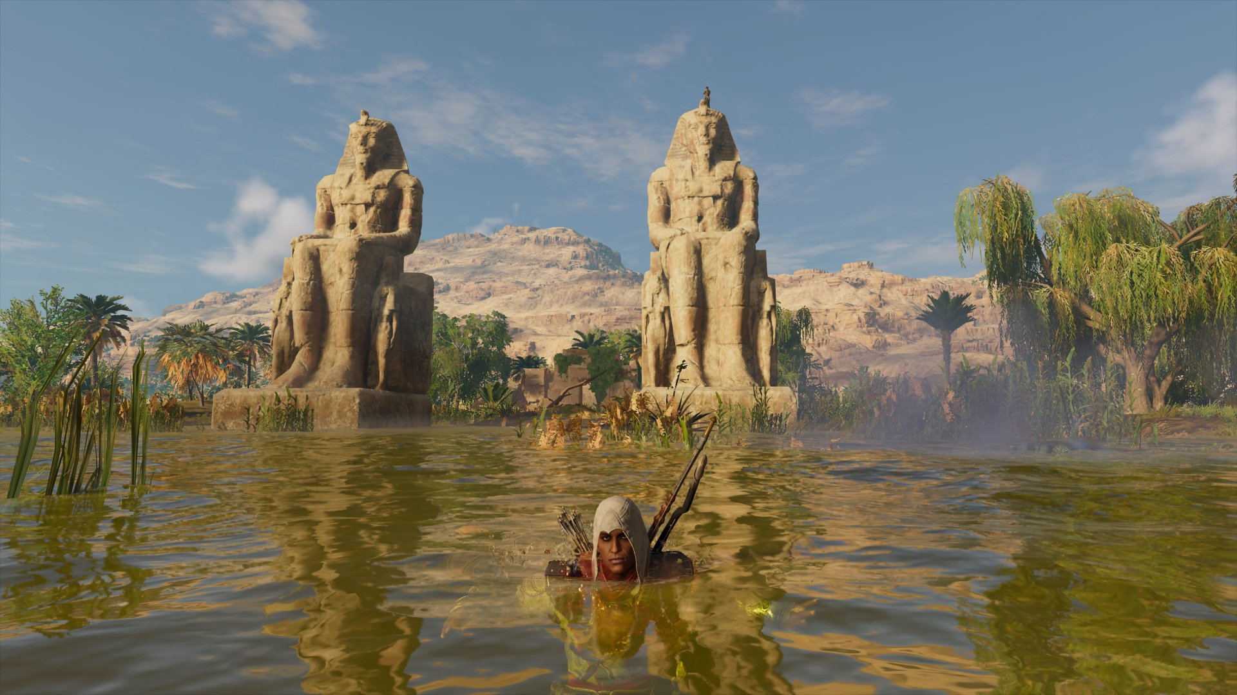

Slide 24
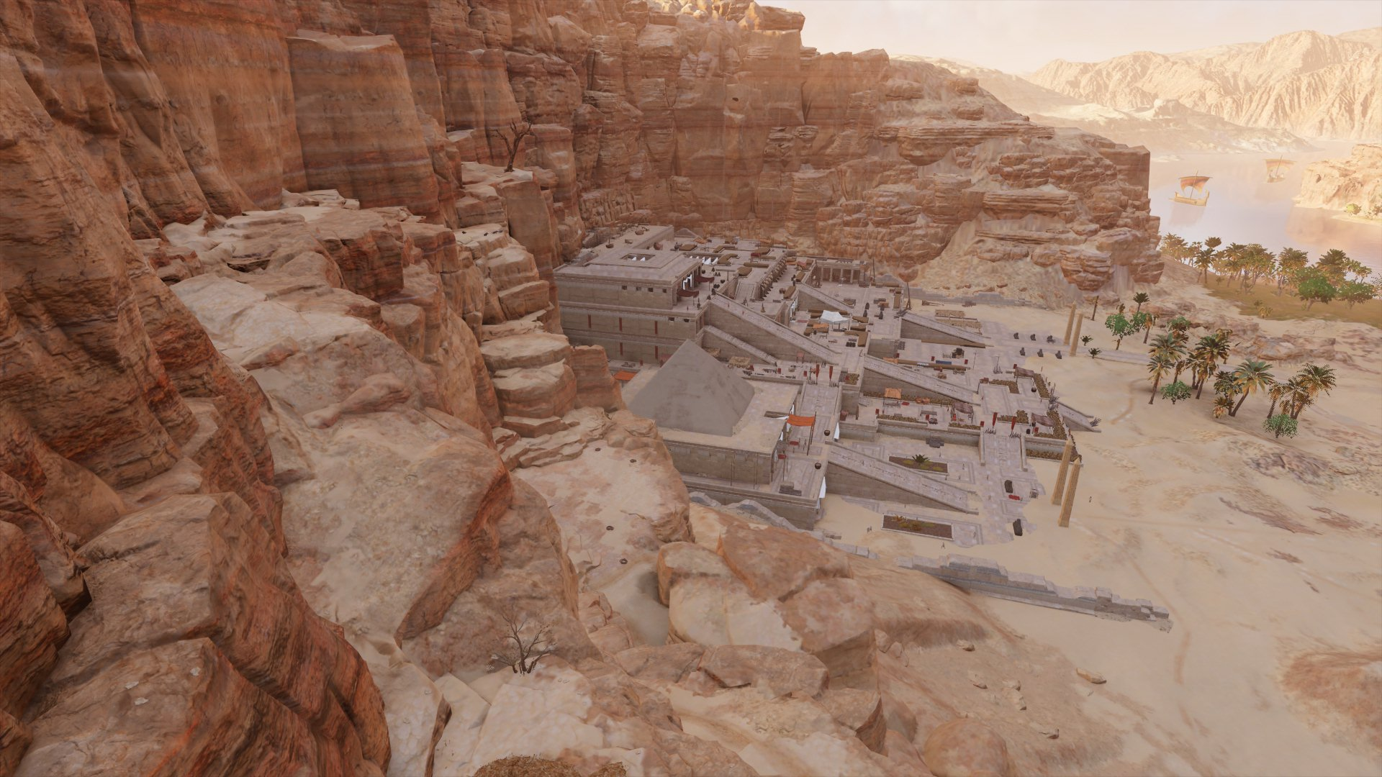

Slide 25
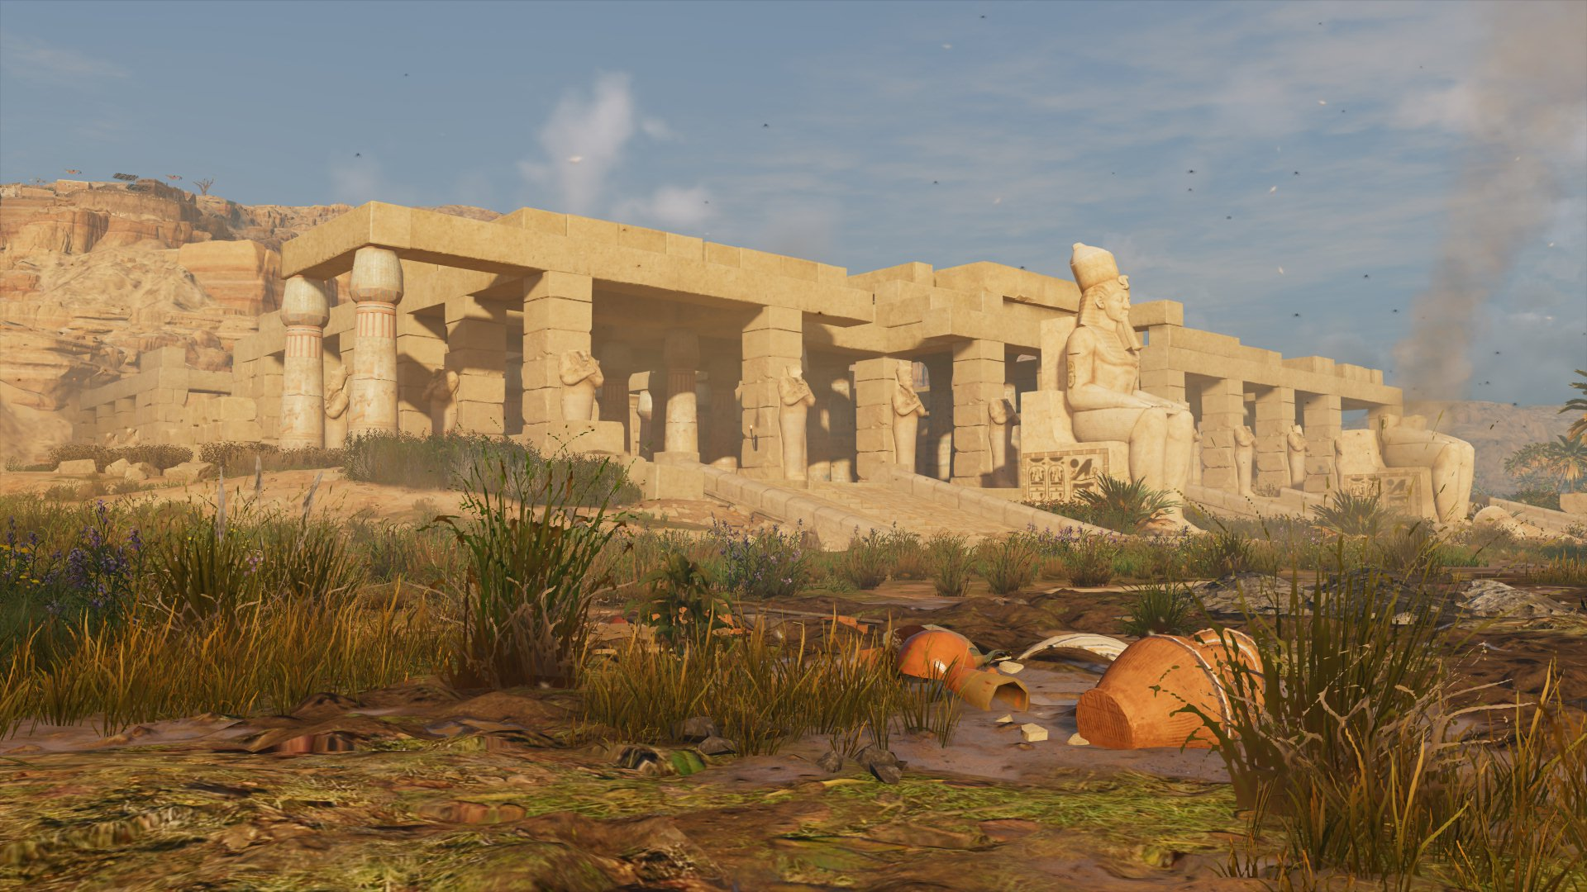

Slide 26
Narrative Representations and Historical Deviations
Cleopatra VII portrayed through Roman and modern stereotypes
– emphasis on seduction, manipulation, political intrigue
– reflects long‑standing femme fatale rather than „real” historical queen
Fictionalized scenes created for dramatic effect
– invented assassination/seduction episodes
– narrative prioritizes emotional impact over historical accuracy
Conspiratorial networks (Hidden Ones)
– integrated into major political events
– proto‑Assassin ideology not grounded in ancient sources

Slide 27
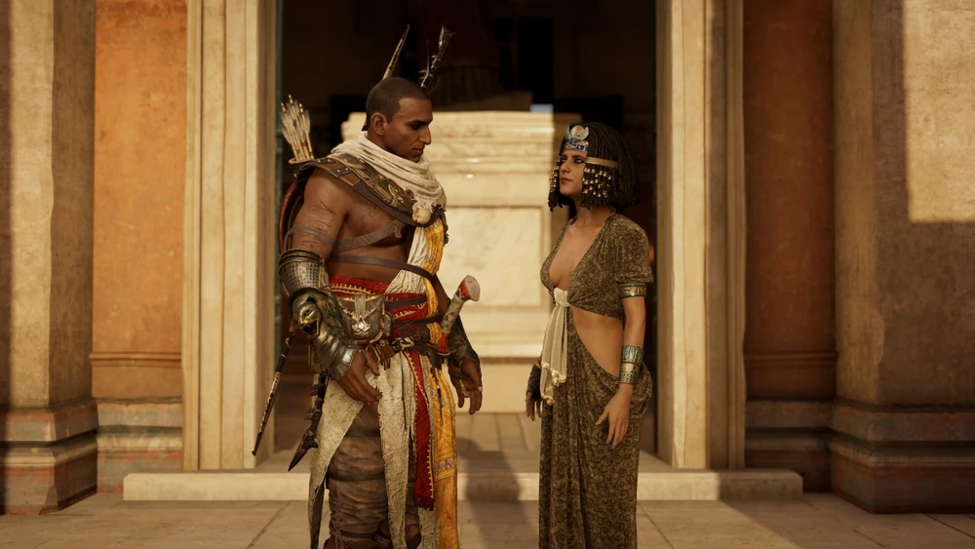

Slide 28
Compressed historical timelines
– events from 49–43 BC merged into a single narrative arc
– simplifies political complexity of the late Ptolemaic period
Anachronistic reconstruction of Thebes
– monumental, fully decorated temples despite diminished Ptolemaic reality
DLC “Curse of the Pharaohs”
– supernatural framing of Akhenaten, Nefertiti, Ramesses II and Tutankhamun – explores cultural memory, not historical events

Slide 29
Technology and Visualizing the Past
Advanced game engine enables large‑scale spatial reconstruction of ancient landscapes
Use of photogrammetry and high‑resolution environmental modeling
Dynamic lighting systems simulate ancient polychromy, shadows, and material textures
AI‑driven crowd behavior recreates urban movement, ritual processions, and daily life
Procedural generation of biomes (Delta, Faiyum, Eastern Desert, oases) enhances realism
Reconstruction of lost or poorly preserved sites (e.g., Memphis) based on scholarly models
Digital phenomenology: experiencing ancient spaces through movement, perspective, and immersion
Demonstrates how modern technology can support public understanding of ancient cultures

Slide 30
Discovery Tour: Ancient Egypt (2018): Educational Mode and Public Outreach
Combat‑free educational mode developed by Ubisoft in collaboration with historians and Egyptologists
Structured as a “living museum” with guided tours across major sites
Covers key topics:
– mummification and funerary practices
– agriculture and irrigation
– architecture and construction
– daily life, crafts, and social structure
– religion, temples, and ritual spaces

Slide 31
Provides curated, source‑based explanations independent of the game’s narrative
Designed for schools, universities, and museums
Makes ancient Egypt accessible to non‑gamers, younger audiences, and the general public
Bridges the gap between academic knowledge and popular digital media

Slide 32
Pedagogical Applications (University Teaching Experience)
Integrated into courses on Ancient Egyptian history, Roman Egypt, and material culture
Helps students visualize:
– urbanism (Alexandria, Memphis, Thebes)
– temple architecture and ritual topography
– pyramids and other type of tombs
– domestic spaces and everyday life
– agricultural landscapes and environmental context
Supports experiential learning through spatial exploration

Slide 33
Encourages critical thinking about:
– historical accuracy
– narrative construction
– popular perceptions of ancient cultures
Effective for students with limited prior exposure to Egyptology
Bridges the gap between textual sources, archaeology, and digital media

Slide 34
Total War: Pharaoh (2023)
Turn‑based grand strategy with real‑time tactical battles
Published by Creative Assembly Sofia/SEGA (2023)
Set during the late 19th and early 20th Dynasties (c. 1180–1150 BC)
Focus on the rise of Ramesses III and conflicts with various Sea Peoples
Visually appealing but mechanically complex strategy game
Not intended as a fully historically accurate reconstruction – prioritizes gameplay balance, faction diversity, and dramatic tension
Represents a different approach to digital Egypt: simulation of political, military, and environmental processes rather than historical reconstruction

Slide 35
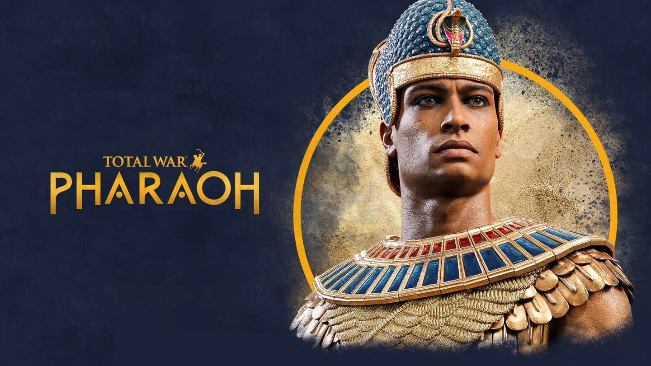

Slide 36
Visual and Gameplay Features
Attractive visual presentation of Late Bronze Age Egypt
Distinctive environmental design: Delta, deserts, fortified cities
Campaign focuses on political instability, invasions, and resource scarcity
Real‑time battles emphasize unit morale, terrain, and weather
Represents Egypt through strategic systems, not spatial reconstruction

Slide 37
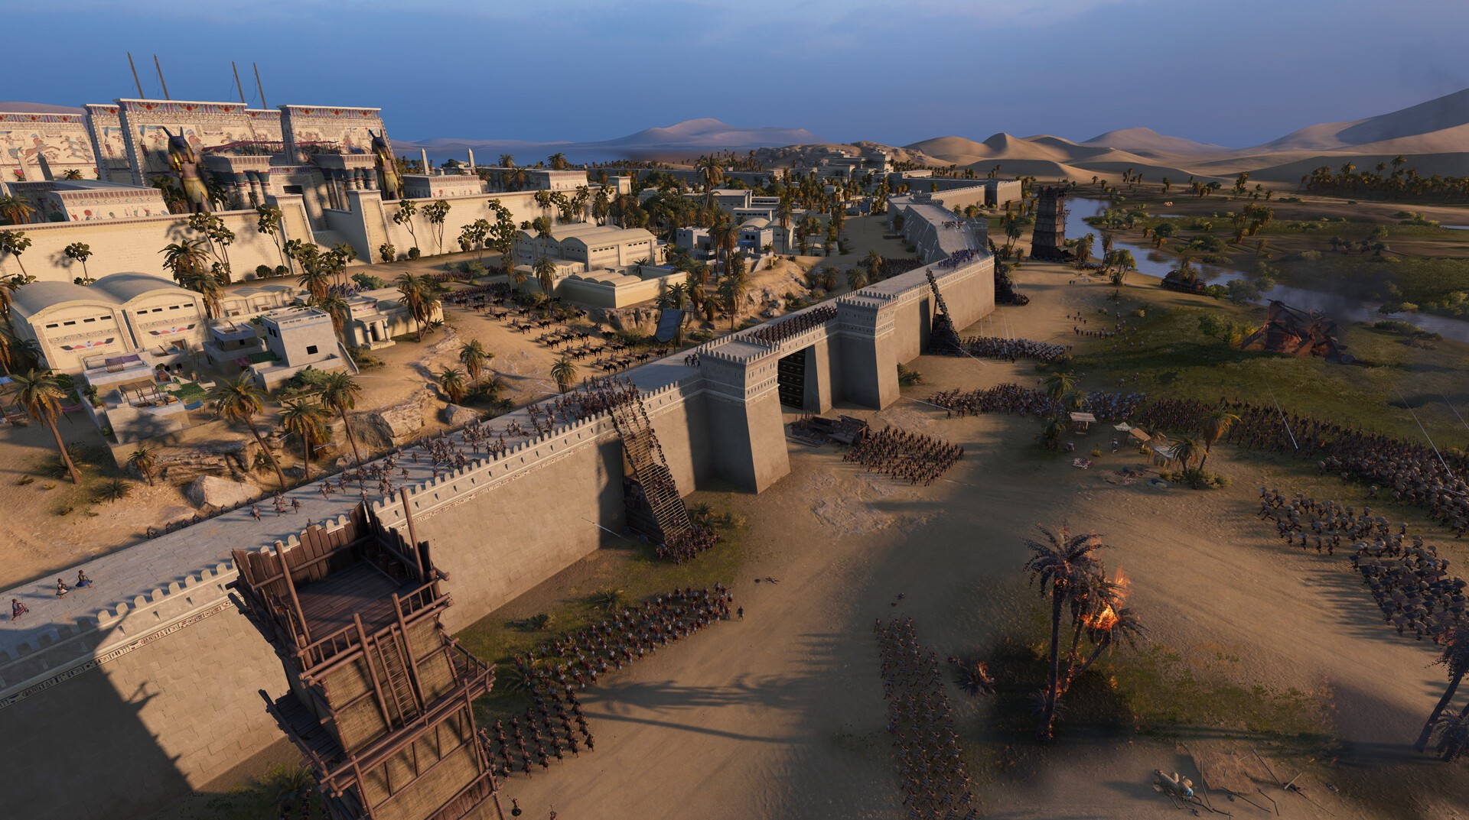

Slide 38
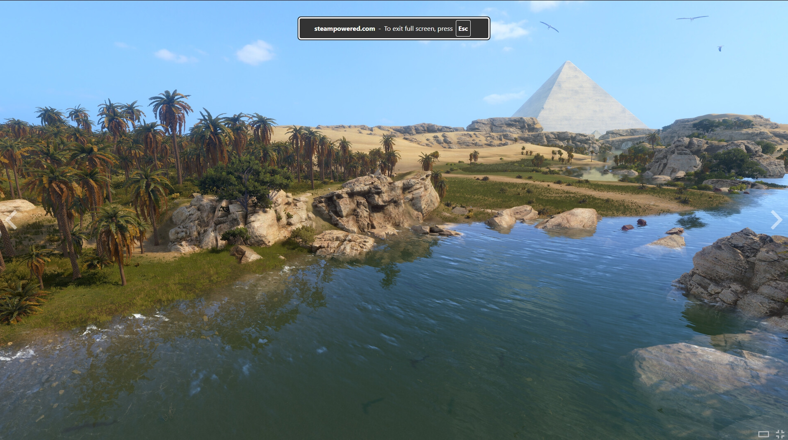

Slide 39
Historical Limitations and Representation Issues
Narrative heavily simplified:
– Ramesses III reduced to a “heroic” archetype
– Sea Peoples portrayed as a unified invading force
Faction system prioritizes gameplay diversity, not historical accuracy
Cities and monuments lack archaeological grounding
Timeline compressed to fit campaign structure
Focus on military conflict overshadows social, economic, and cultural aspects
Useful as an example of how strategy games reshape history for playability
Shows a different model of digital Egypt: simulation of processes, not reconstruction of spaces
Highlights challenges of balancing history vs. gameplay

