Slide 1
Reception of Ancient Egypt in the video (computer) games published in the last 20 years
(2004/2005. – 2024/2025)
Mladen Tomorad
Department of History, Faculty of Croatian Studies, University of zagreb

Slide 2
Introduction
Since late 1980’s a whole series of games were released for different types of computer and consoles which were inspired by the ancient past.
Small part of them were set in Ancient Egyptian background or were inspired by its culture as part of widespread Egyptomania
This type of media became especially important for Egyptomania in the last 20 years
  series of different type of games (RPG, RTS, action adventure, strategy games etc.)

Slide 3
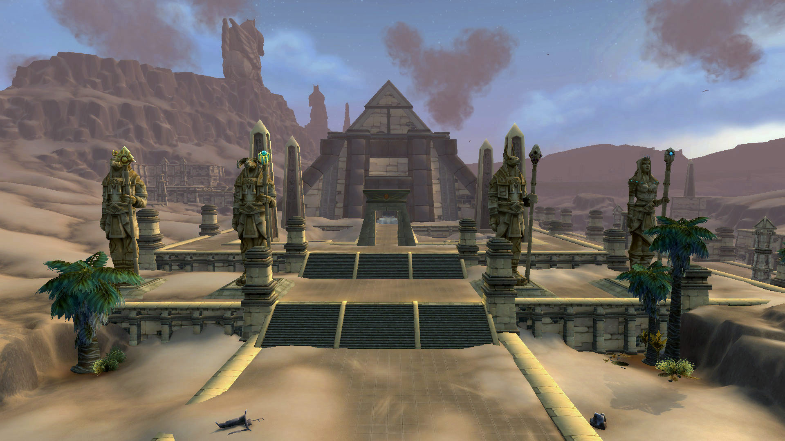
World of Warcraft (2004/2005 - )
MMORPG published by Blizzard Entertainment in Autumn 2004 (USA)/Spring 2005 (Europe)
Two territories in its western continent Kalimdor inspired by ancient Egyptian civilization
  Silithus
  Uldum

Slide 4
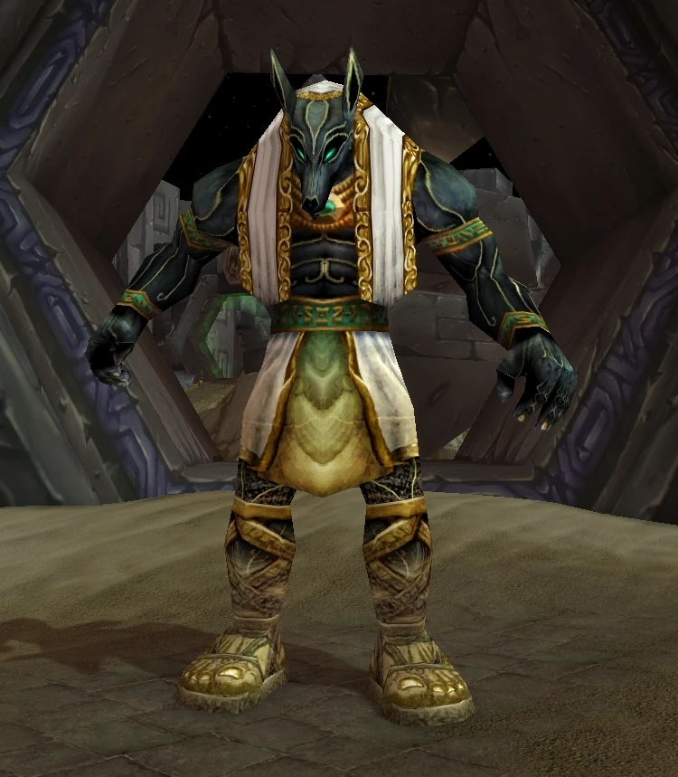
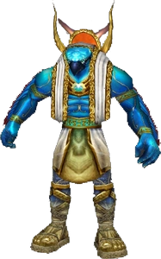
WoW: Silithus
region from the original game
Temple of Ahn’Qiraj (40 men dungeon, Summer 2006)
  Anubisath/Setis (guardians)
Ruins of Ahn’Qiraj (10 men dungeon, Summer 2006)
  Horusath (guardians)
  Ossirian the Unscarred (dungeon main boss)

Slide 5
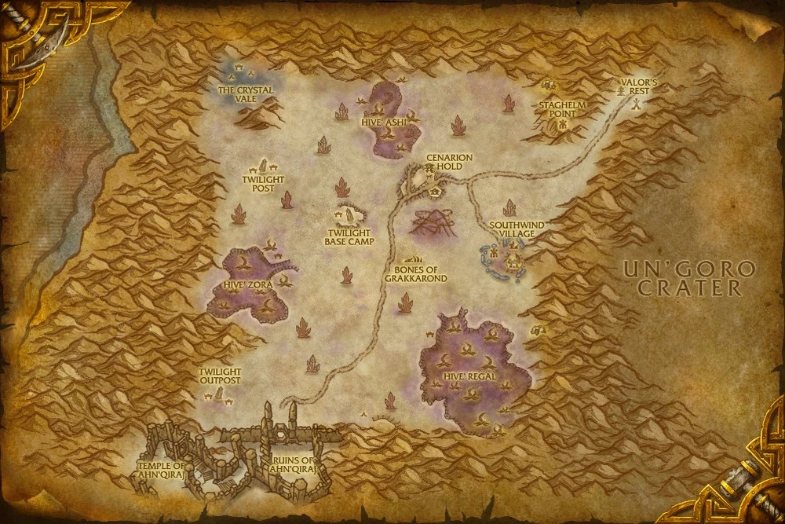

Slide 6
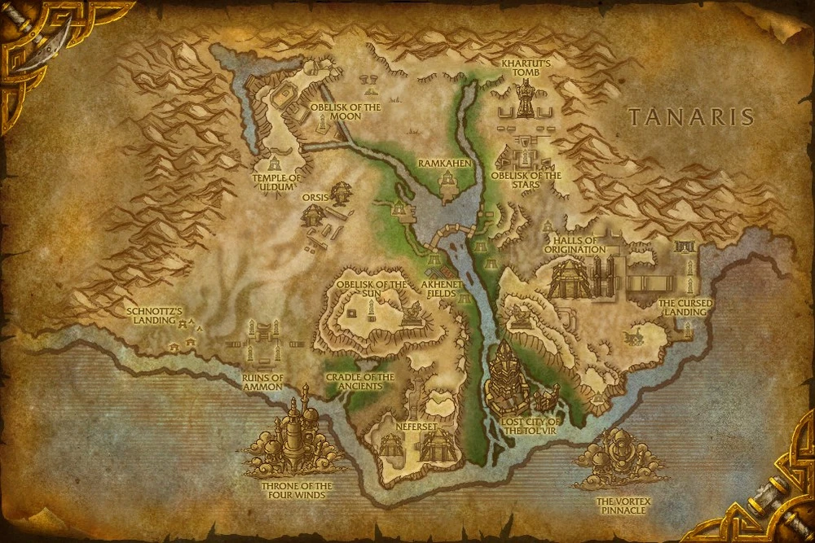
WoW: Uldum
New region available since Cataclysm expansion (2010)
Completely inspired by Nile region
Pyramids and typical flora/fauna related with Egypt (vultures, hyenas, lions, crocolisk, scarabs, scorpids, snakes, wasps, camels, hawks etc.)

Slide 7
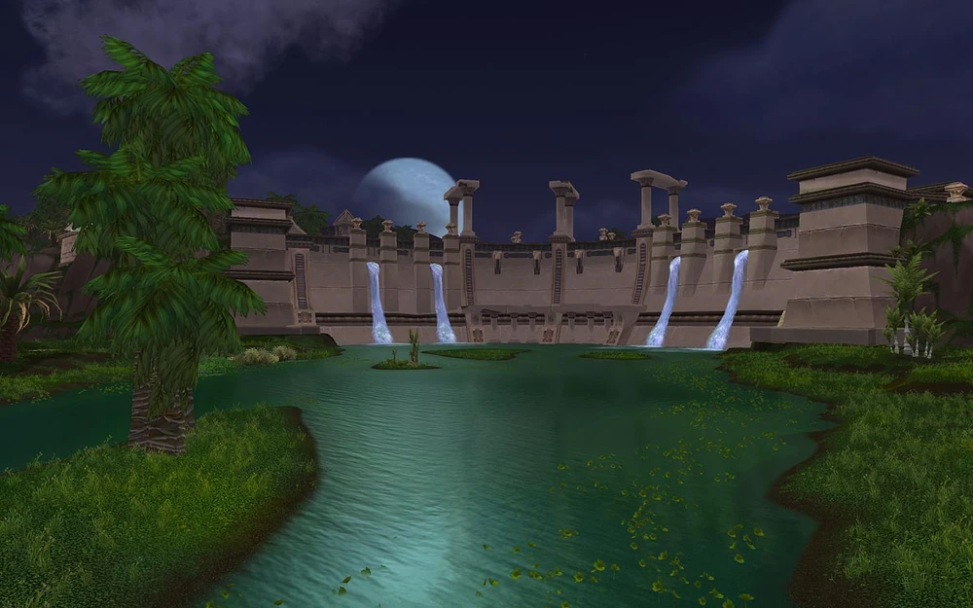
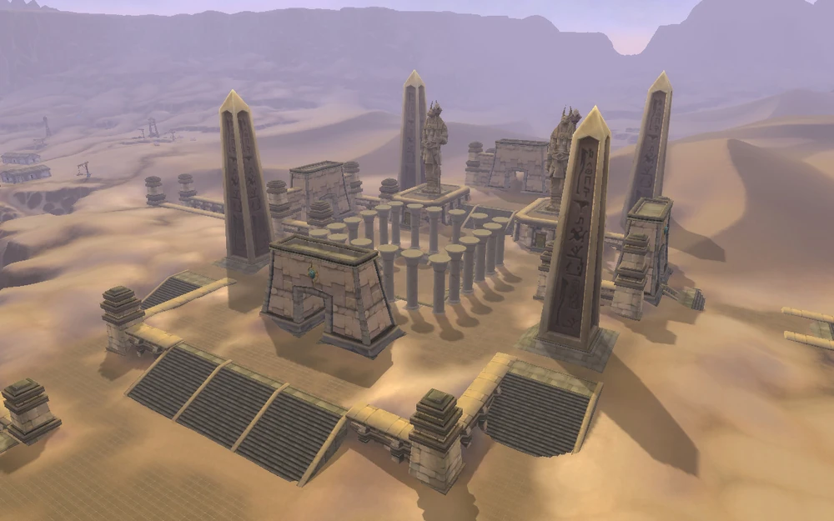
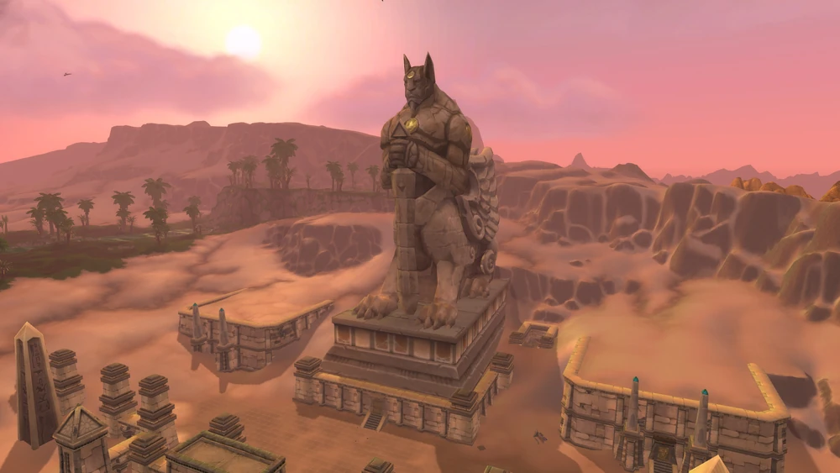
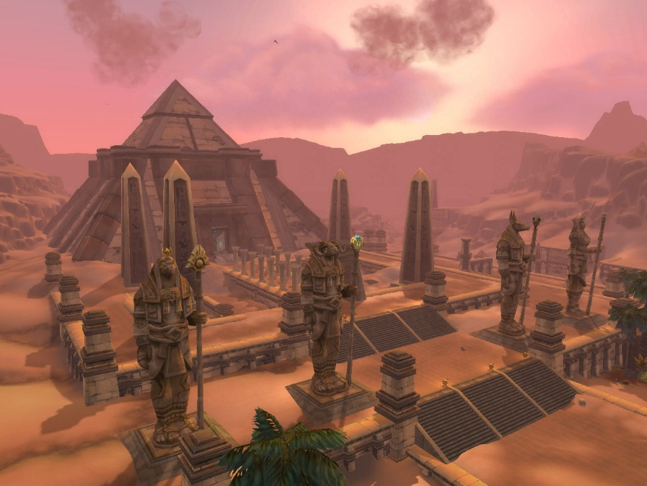

Slide 8
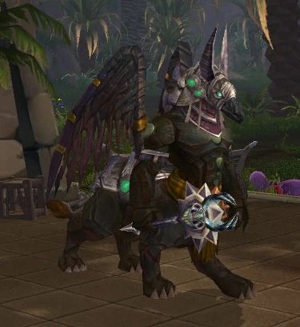
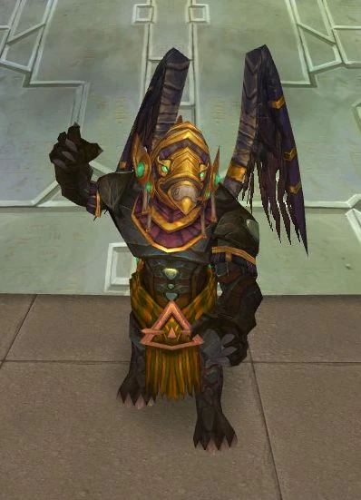
Several dungeons inspired with ancient Egypt
Lost city of Tol’vir (5 men dungeon)
Sprinx like creatures
Dark Pharaoh Tekahn (boss)
Cyrus the Black (boss)

Slide 9
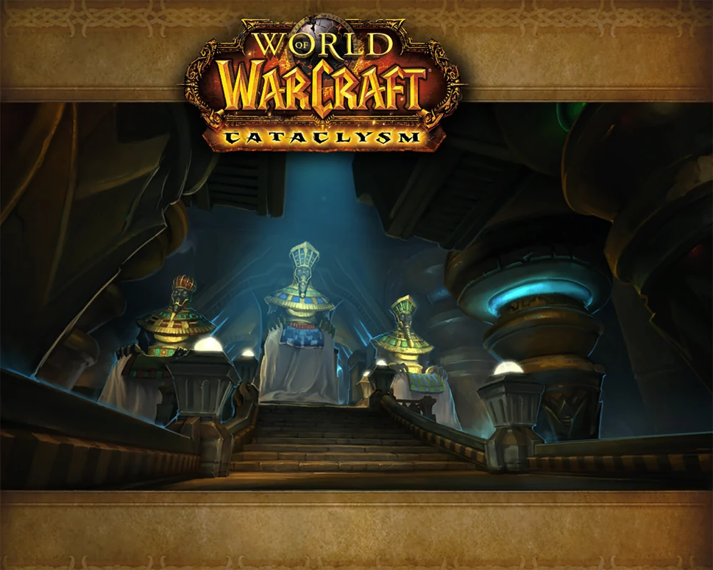
Halls of Origination (5 men dungeon) with 4 bosses:
Isiset
Ammunae
Setesh
Rajh

Slide 10
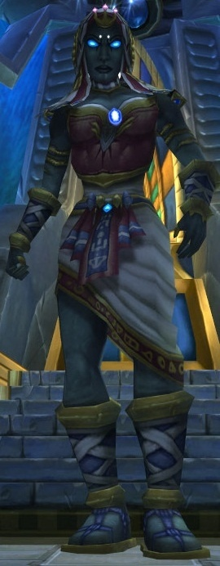
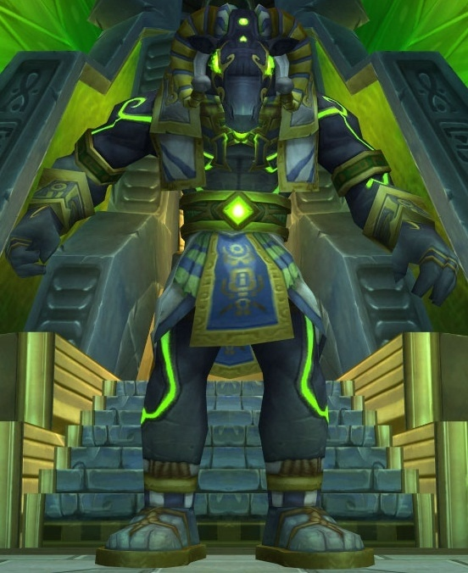
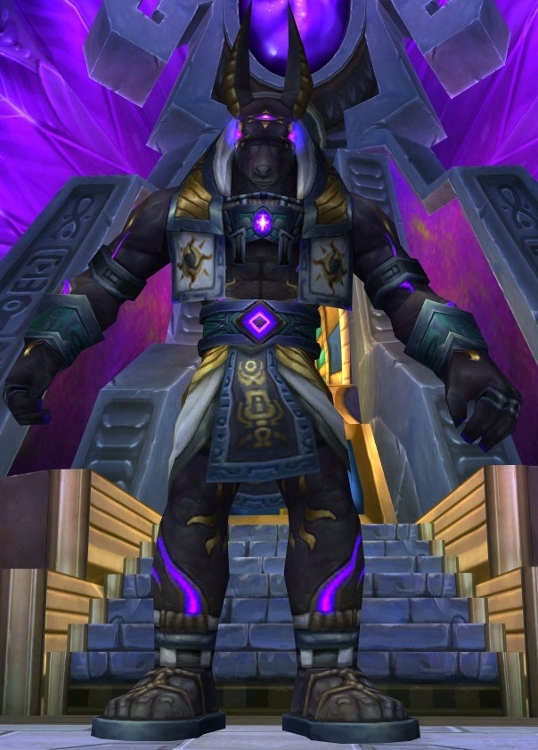
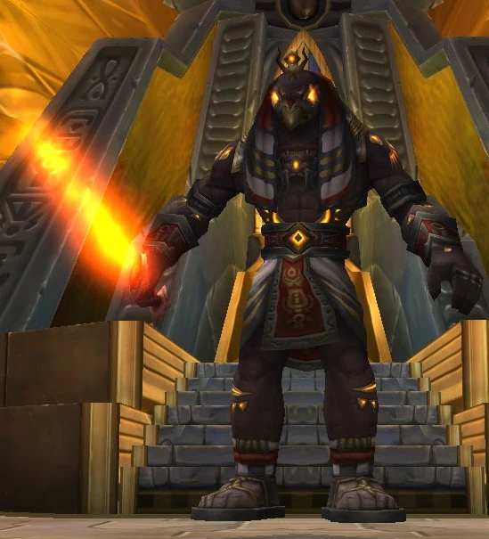

Slide 11
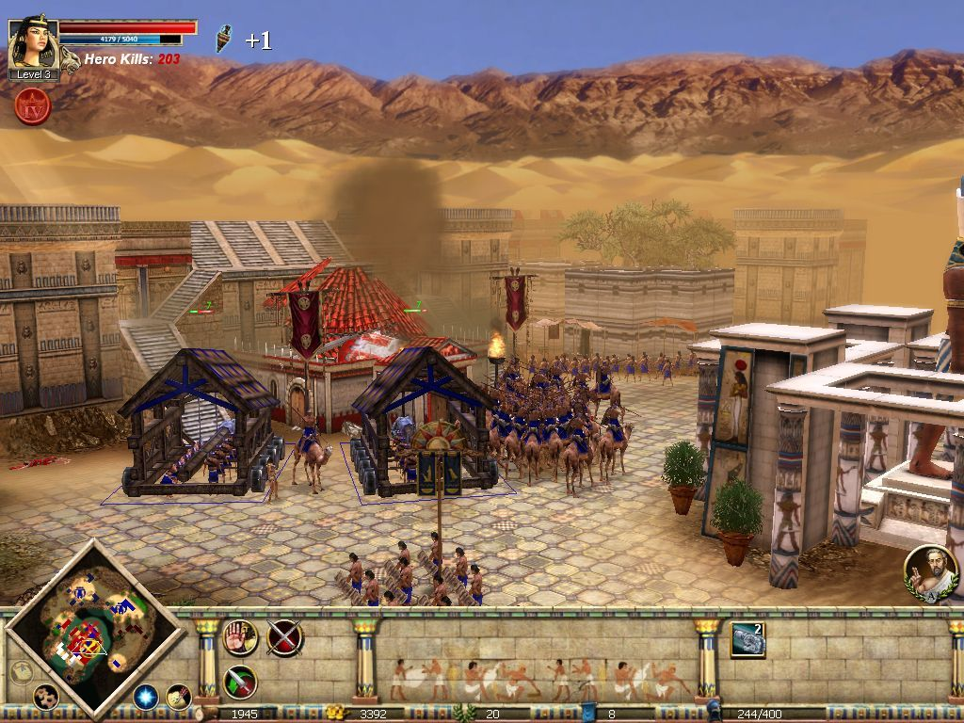
Rise and Fall: Civilizations at War (2006)
Single player strategy game
Published by Midway Games (2006)
Fictional campaign of liberation of Egypt from Rome led by Cleopatra
Cleopatra kills Octavian in duel by dies from mortal wounds

Slide 12
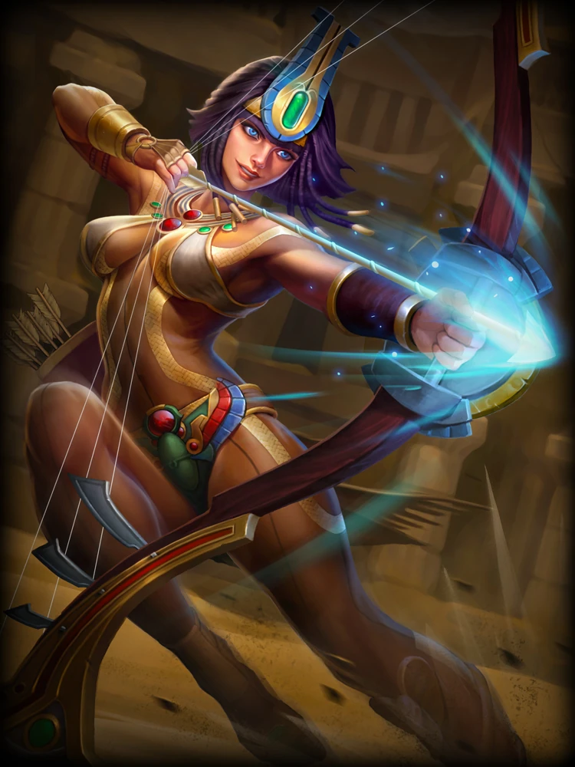
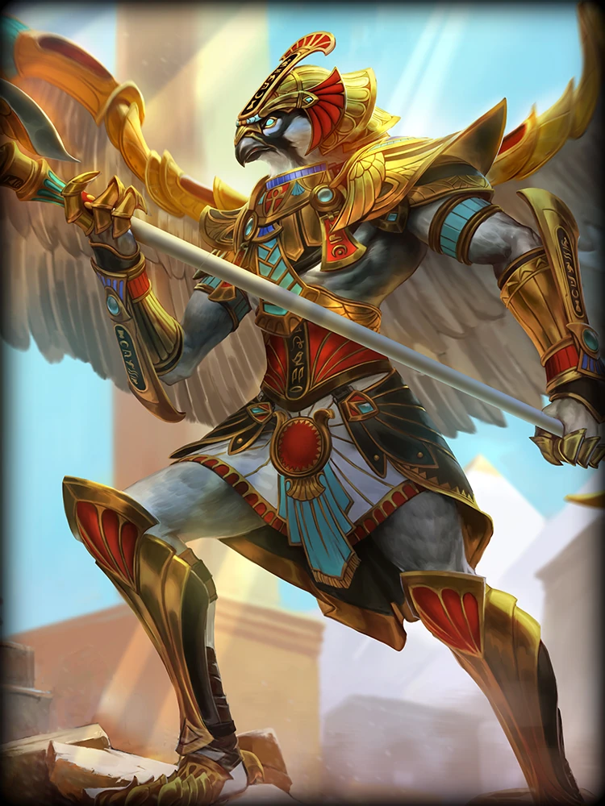
Smite(2014)
PvP game
Published by Hi-Rez Studios (2014)
112 ancient gods/goddessess from various worlds religions with different abilities
Selection of 15 Ancient Egyptian gods: Anhur, Anubis, Bastet, Eset, Get, Horus, Khepri, Neith, Nut, Osiris, Ra, Serqet, Set, Sobek, Thoth

Slide 13
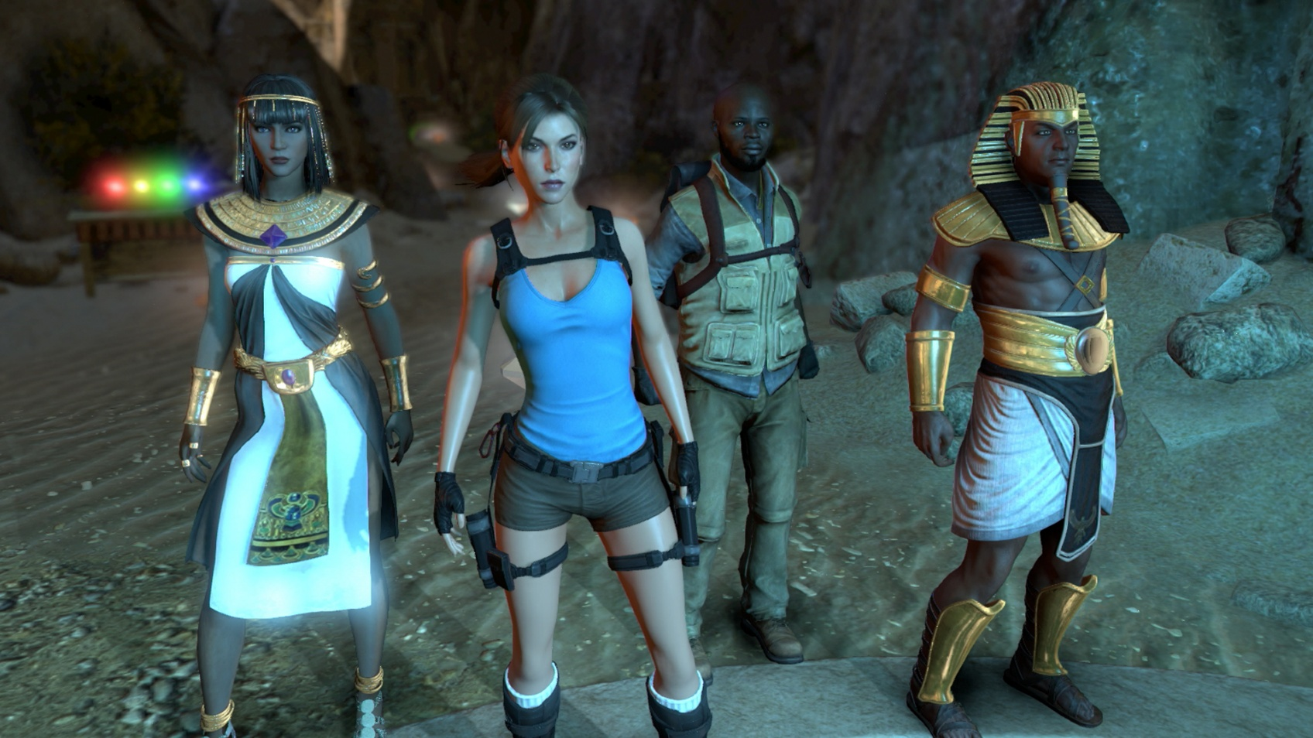
Lara Croft and the Temple of Osiris (2014)
Action adventure game
Published by Crystal Dynamics Studio (2014)
Lara explores ancient Egyptian temple in search for various treasure
Various mysteries to solve
Co-op option for 4 players

Slide 14
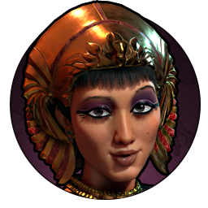
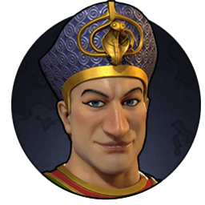
Civilization VI (2016)
Strategy game with goal to develop a civilization from early stone age settlements to the global superpower
Published by Firaxis Games (2016)
19 different nations/leaders
In 2022 various leaders were added: Cleopatra and Ramses

Slide 15
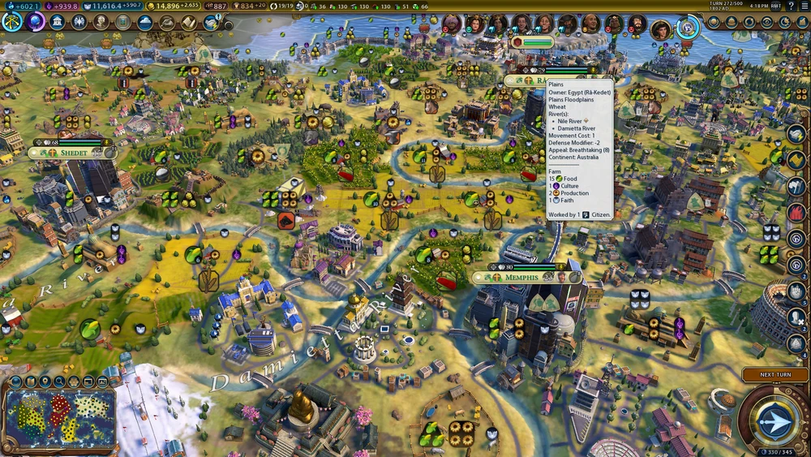
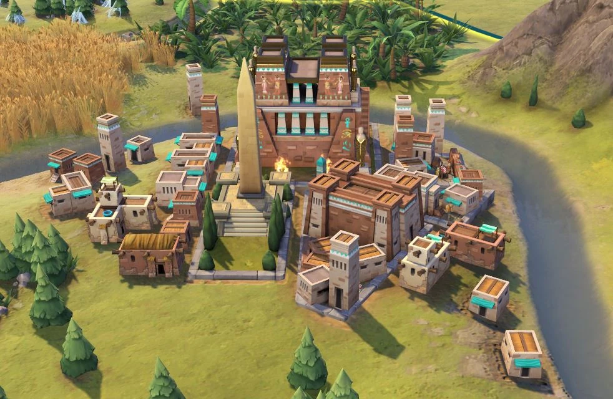
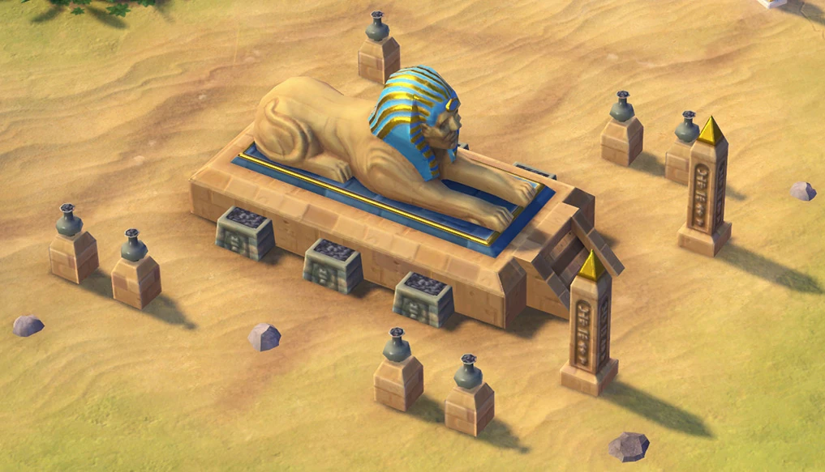

Slide 16
Assassin’s Creed: Origions (2017)
Action RPG
Published by Ubisoft (2017)
player takes on the role of the warrior Bayek, the protector of the Egyptians in the period of the late Ptolemaic kingdom, and his wife Aya, the first "assassin".
Story is set during the Civil war between Cleopatra VII and Ptolemy XIII (48 – 47 BCE)
Two DLC are set in the period from 40 to 36 BCE in Sinai and Theban region but with fictional story
Beautiful game with impressive story and pretty accurate representation of daily life, religious customs, historical events and ancient Egyptian architecture during the late Ptolemaic period
Includes Discovery Tour of Ancient Egypt

Slide 17
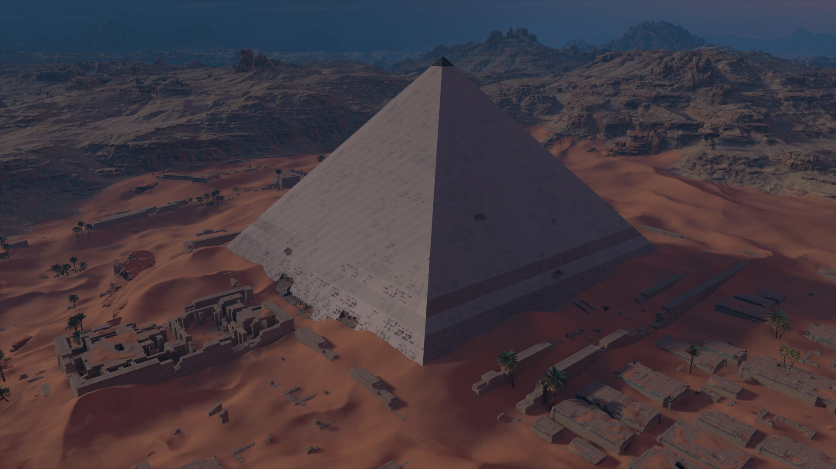

Slide 18
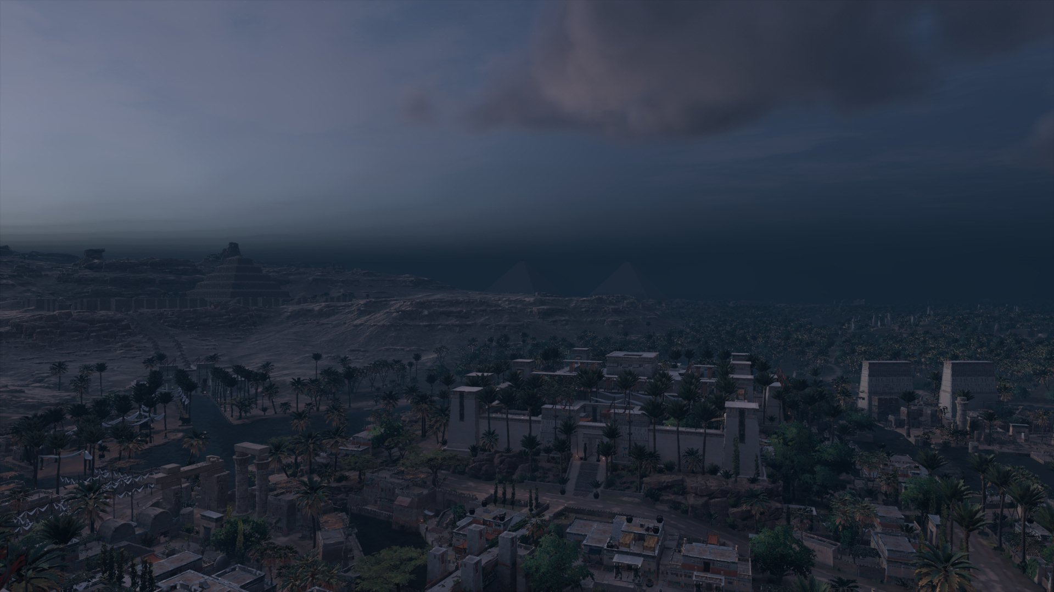

Slide 19
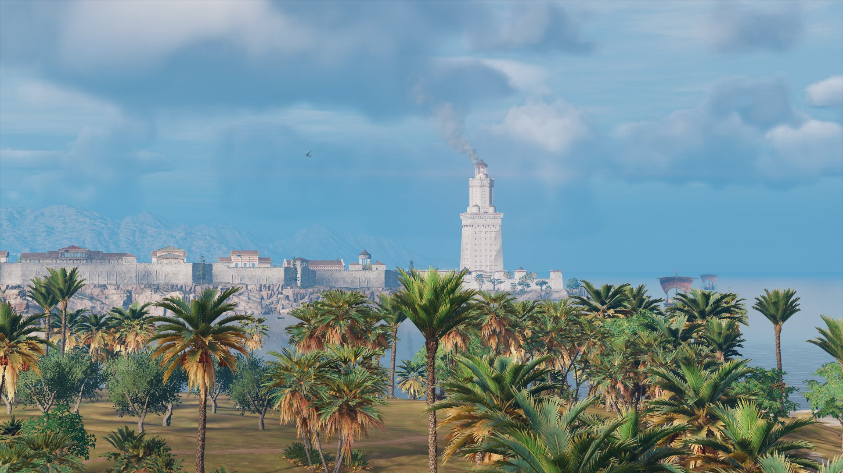

Slide 20
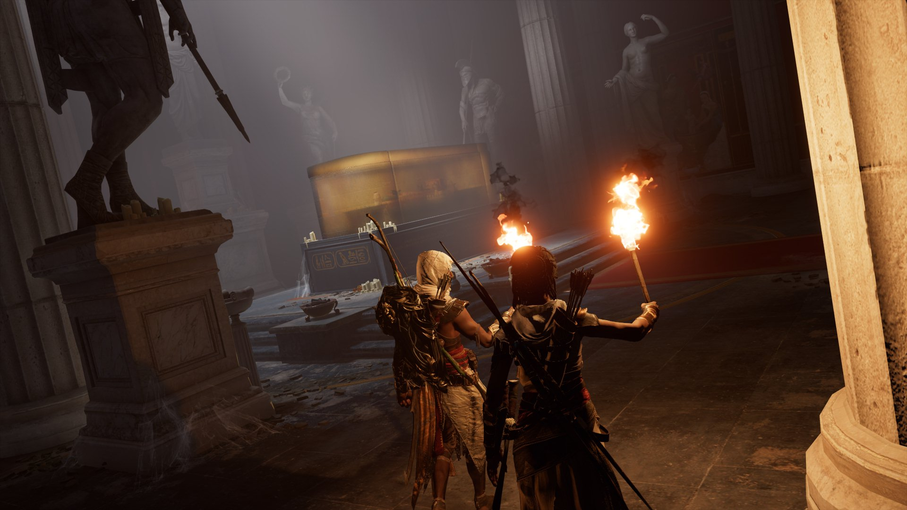

Slide 21
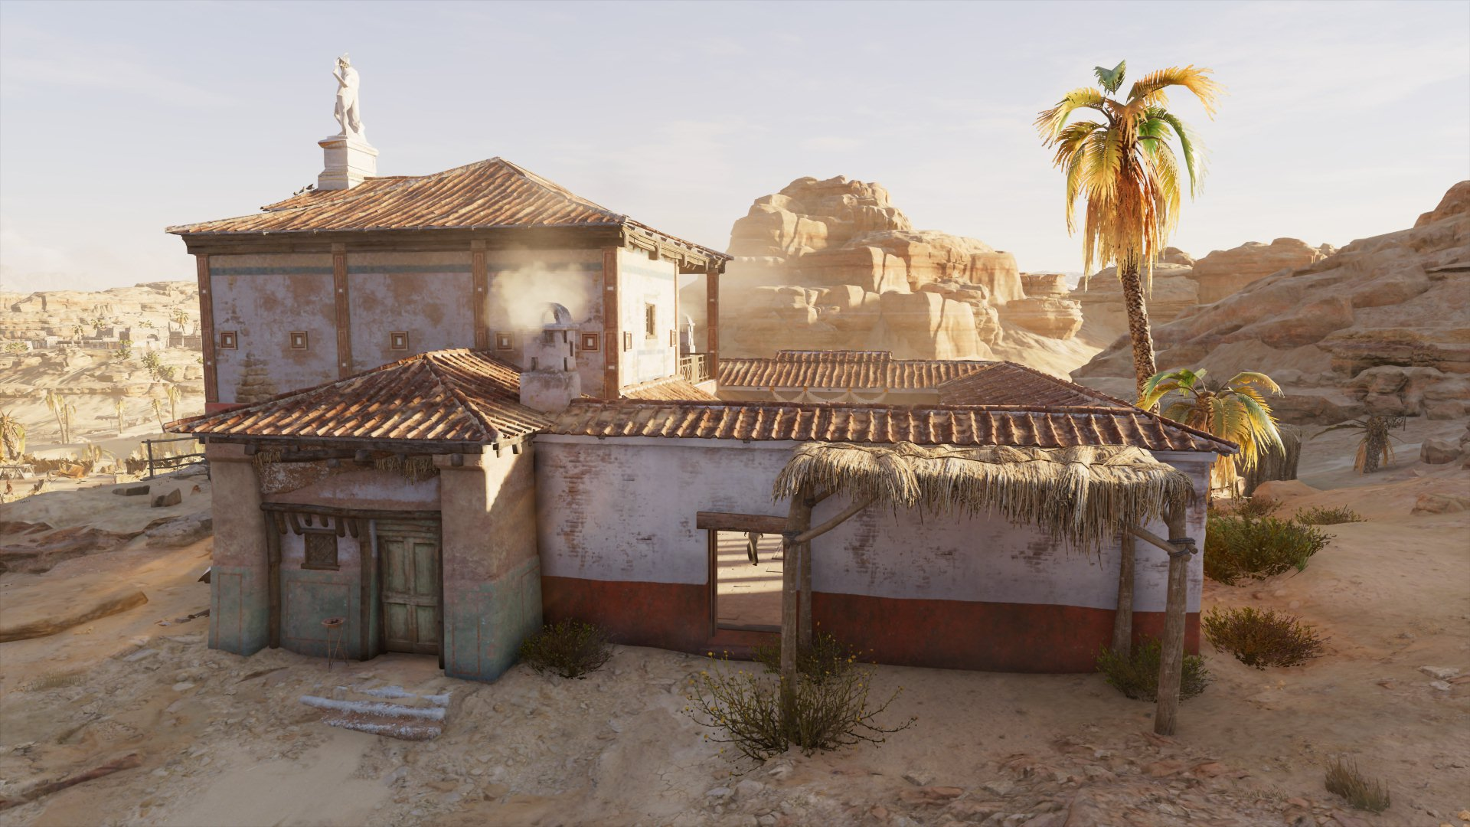

Slide 22
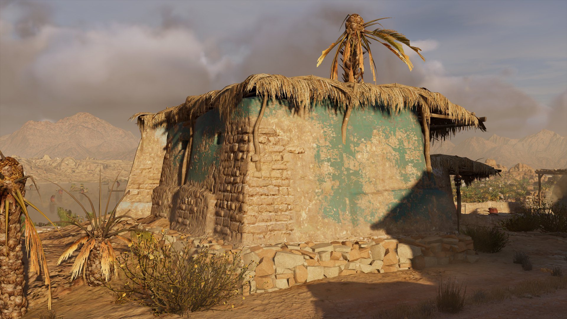

Slide 23
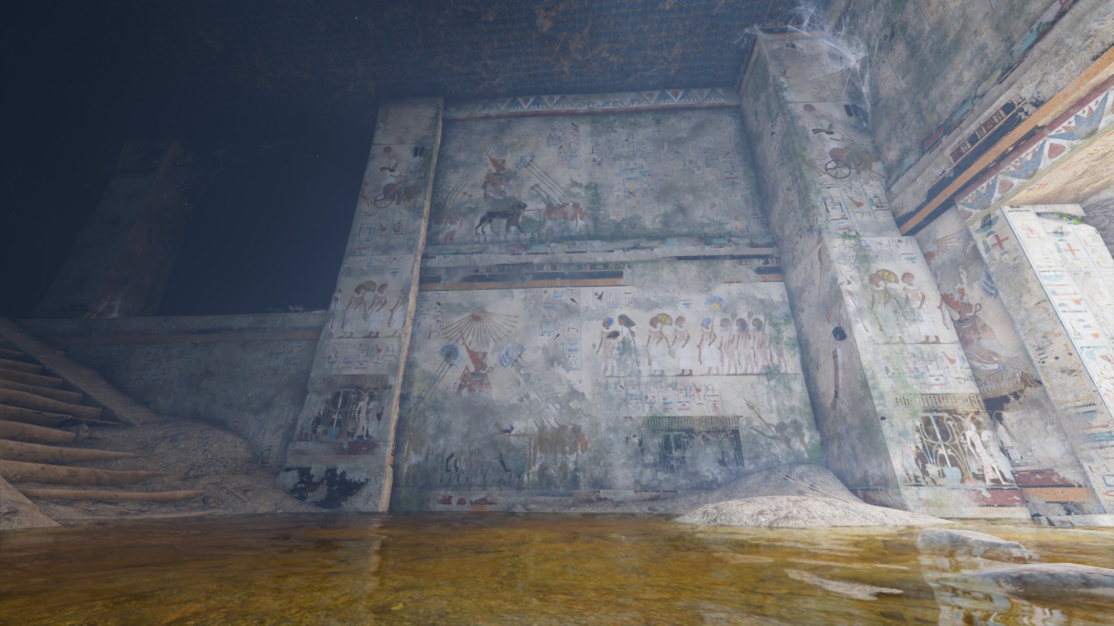

Slide 24
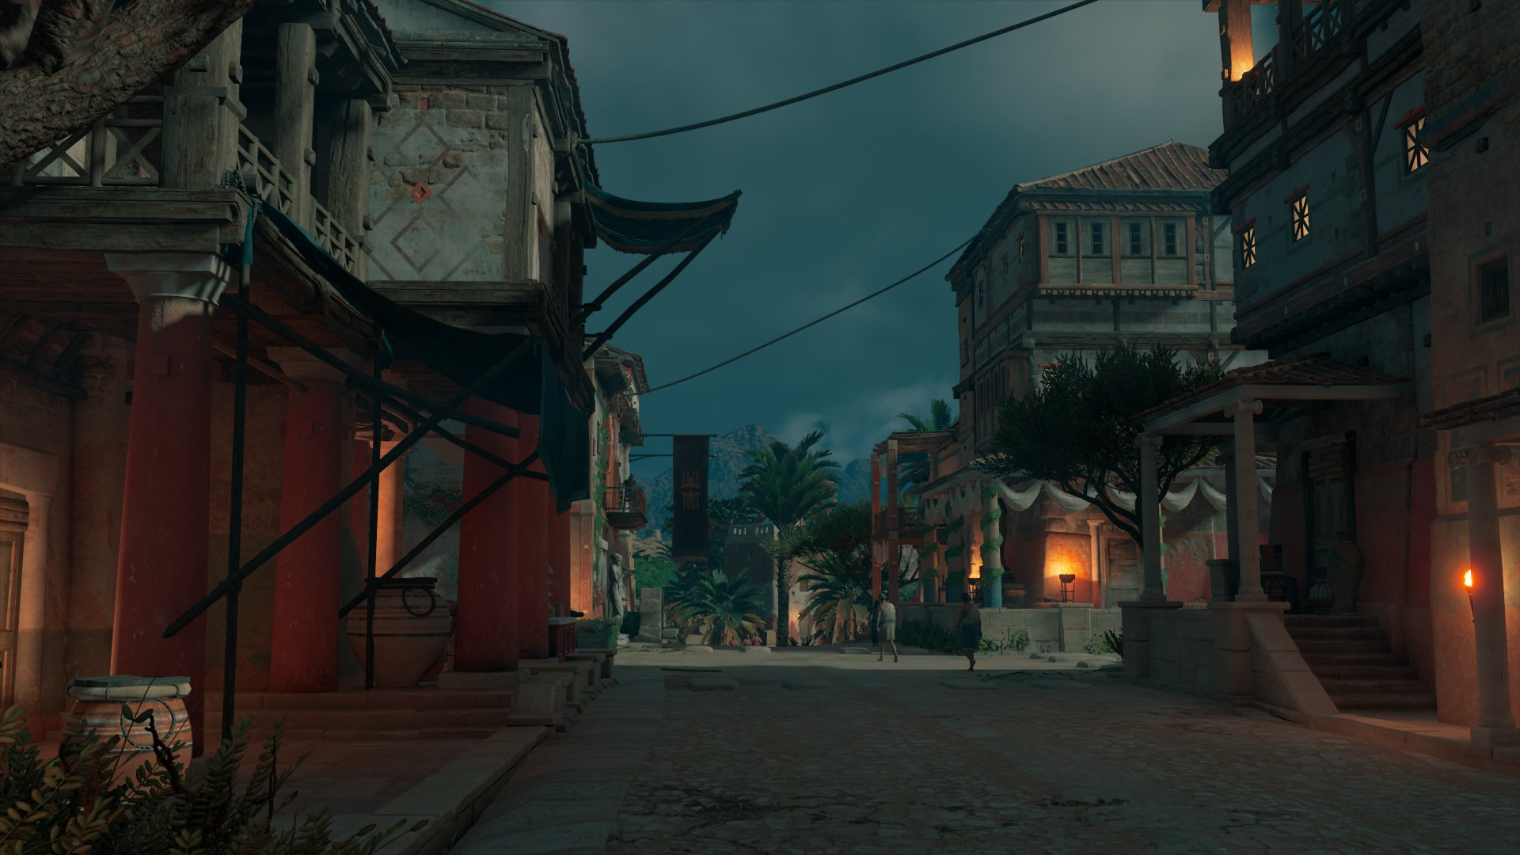

Slide 25
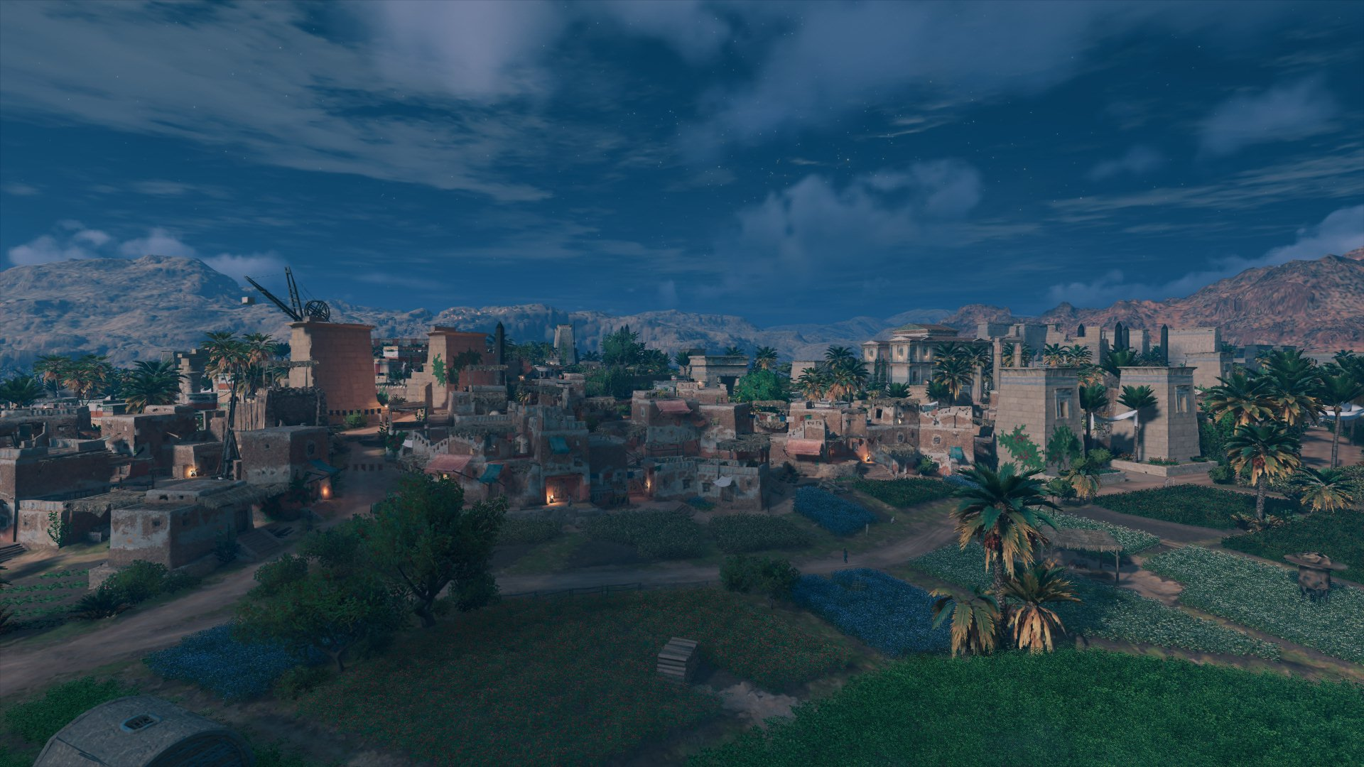

Slide 26
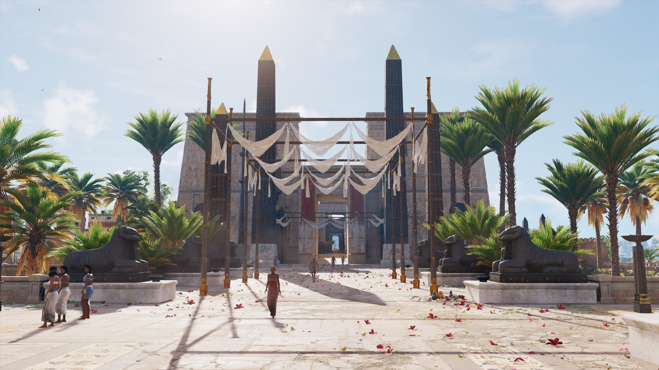

Slide 27
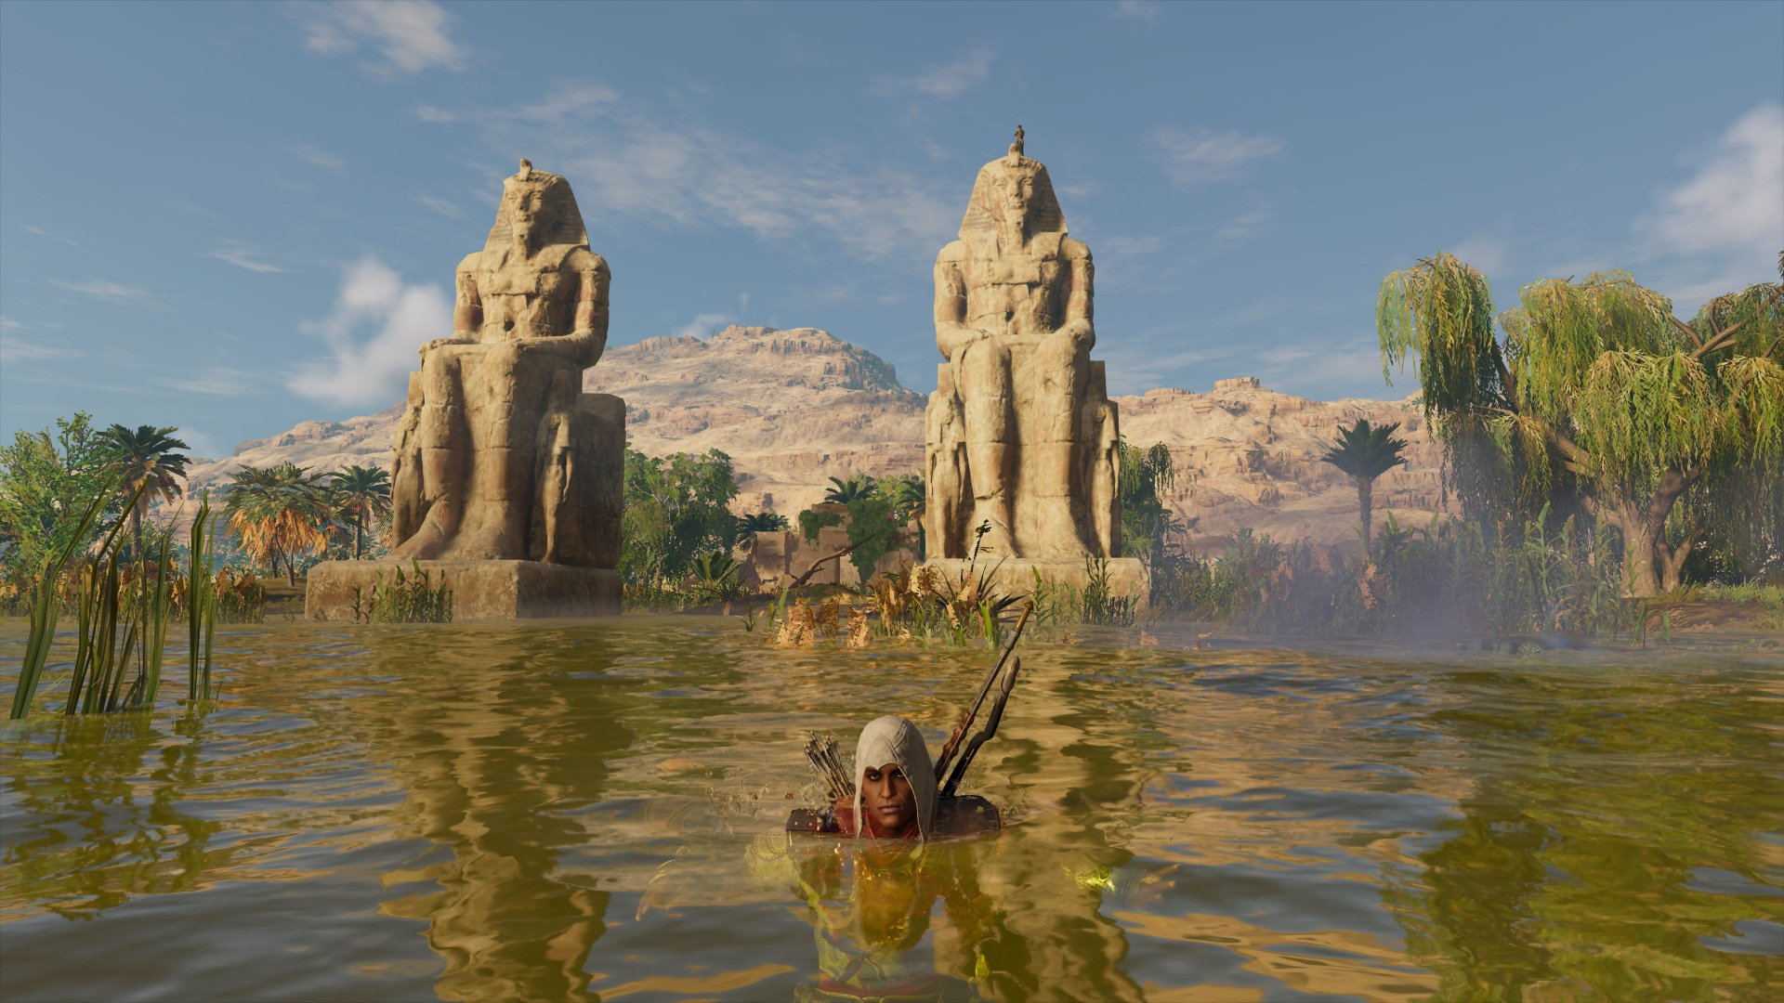

Slide 28
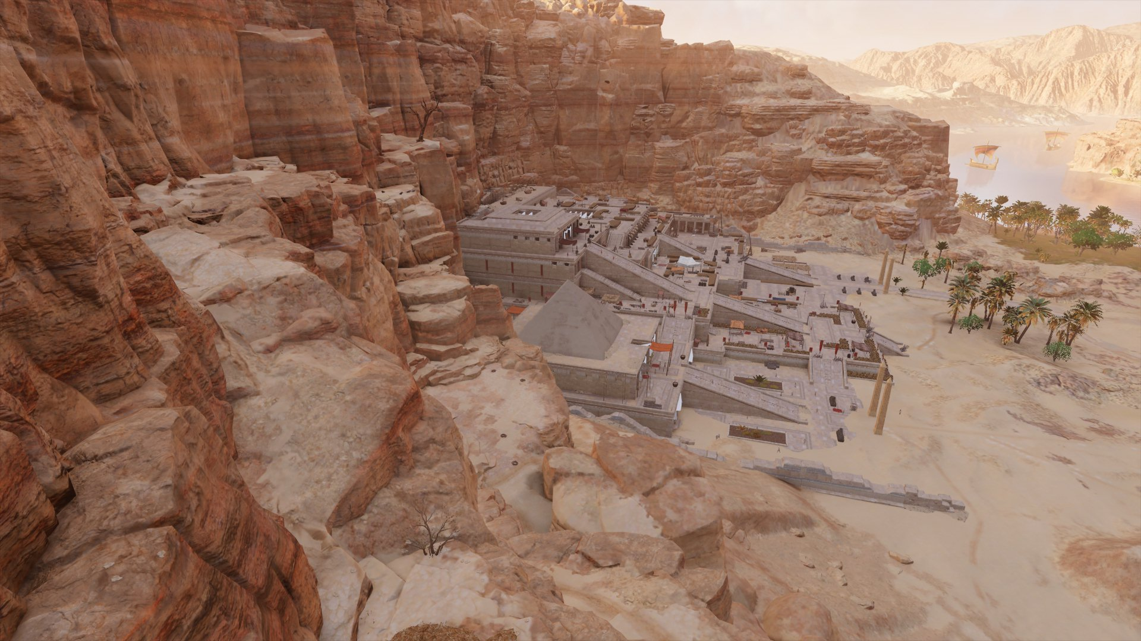

Slide 29
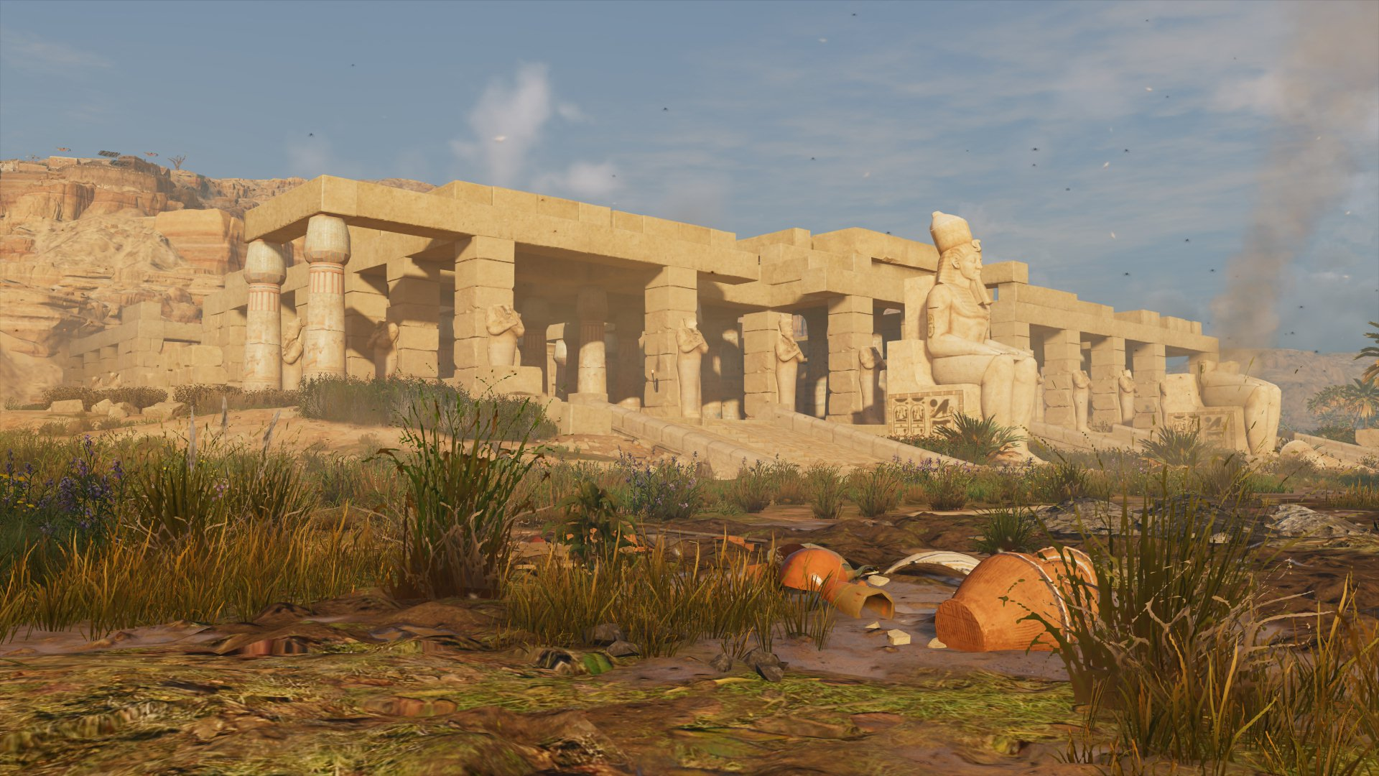

Slide 30

Horizon: Forbbiden West (2022)
Action RPG
Published by Guerrilla Games/Sony Interactive Entertainment (2022)
Story set in far post-apocalyptic future in the western North America
Young female Aloy is trying to save the life on Earth from extinction
In ruins of San Francisco, she finds pyramid like structure completely decorated with ancient Egyptian artefacts

Slide 31
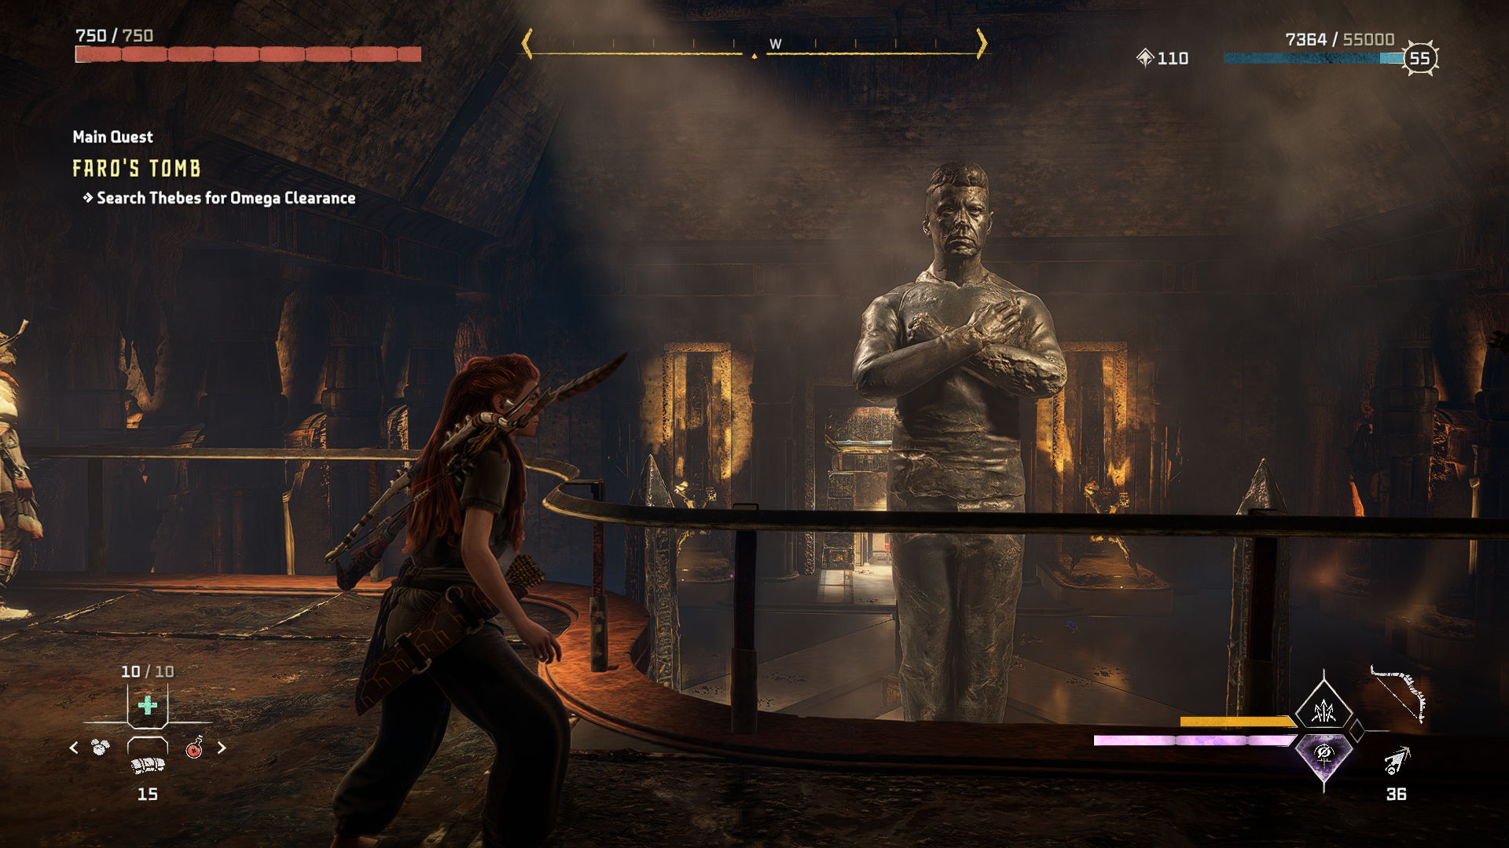

Slide 32
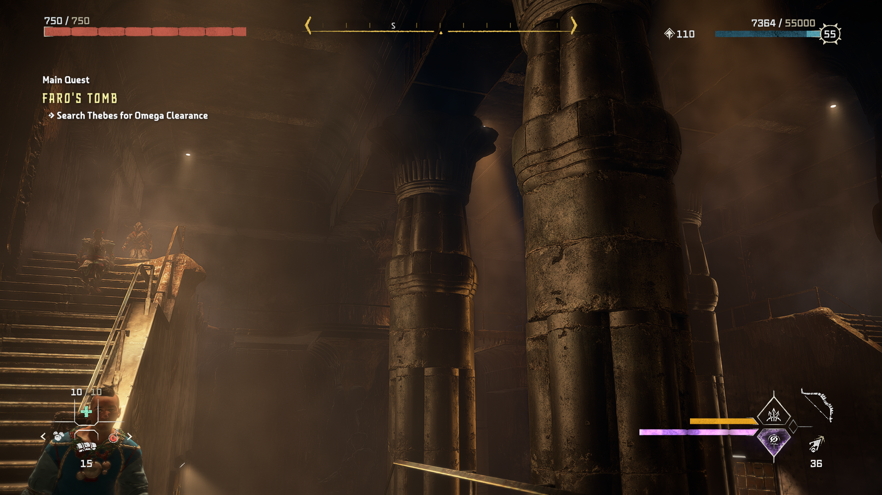

Slide 33
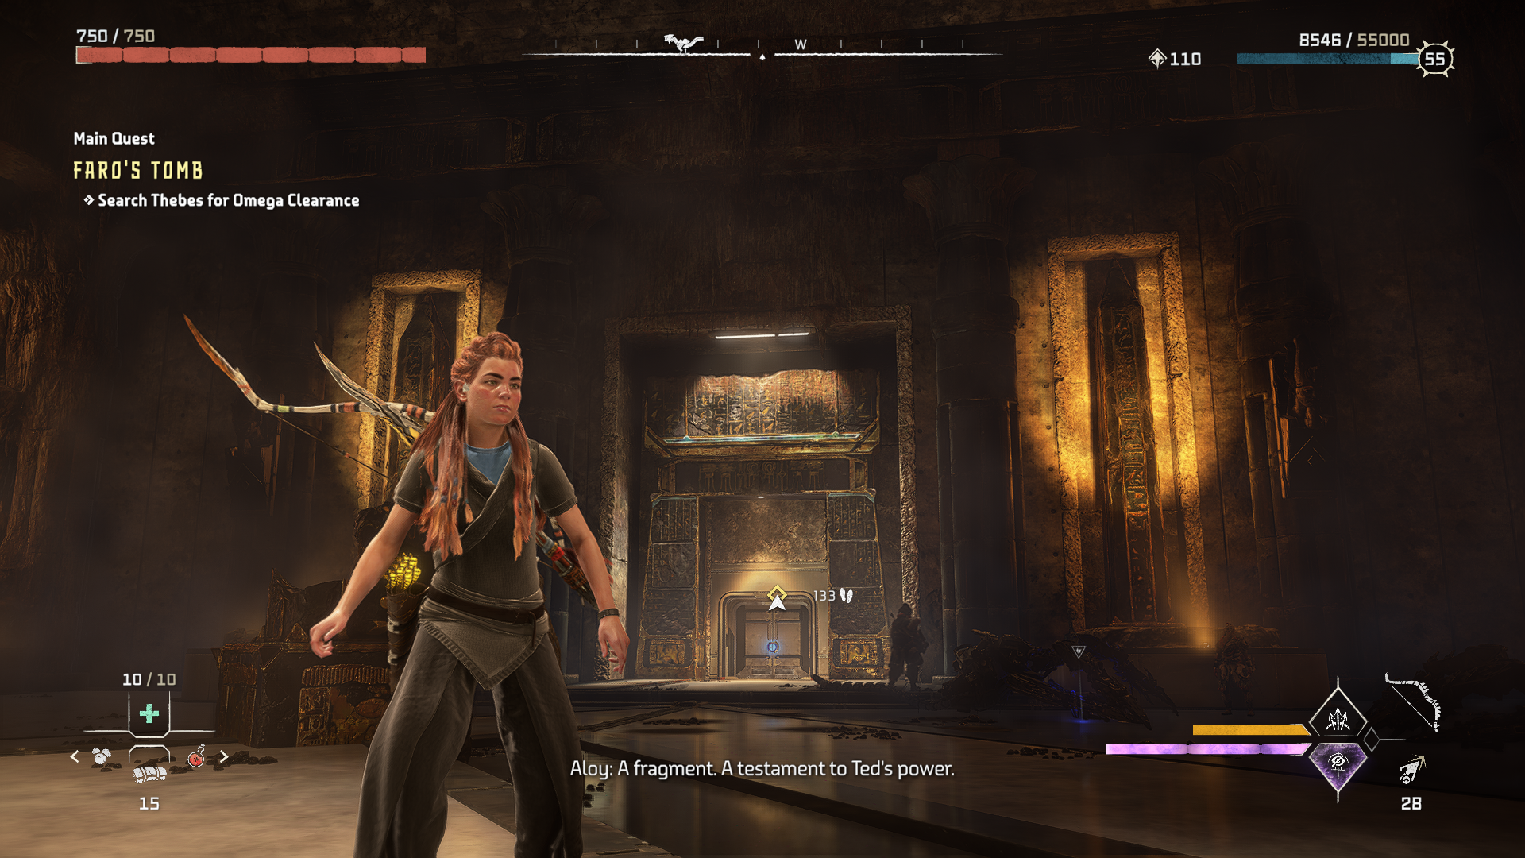

Slide 34
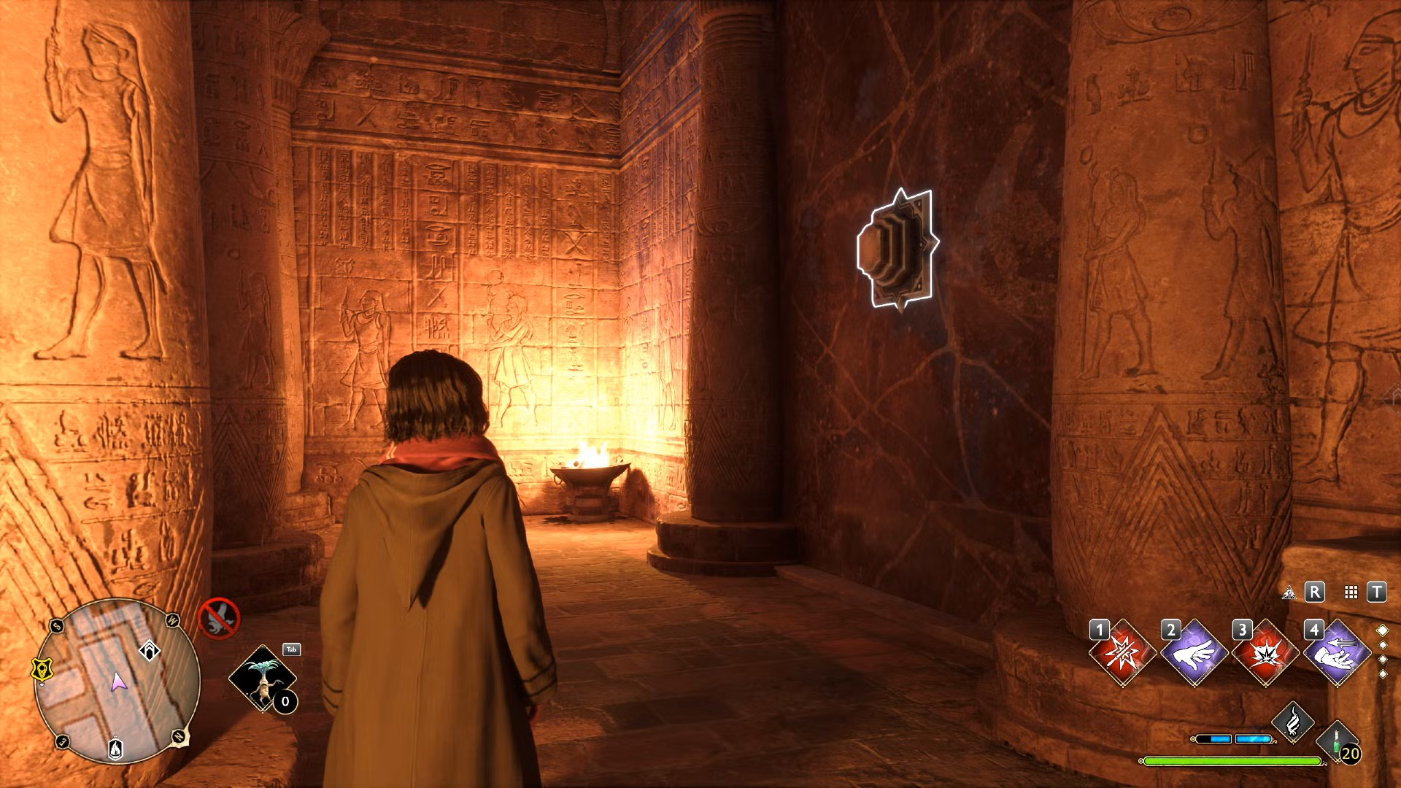
Hogwarts Legacy (2023)
Action RPG
Published by Warner Bros Games (2023)
Story set in the late 19th century in Harry Potter wizarding world
Elements of Egyptomania – secret ancient Egyptian room in Hogwarts castle

Slide 35
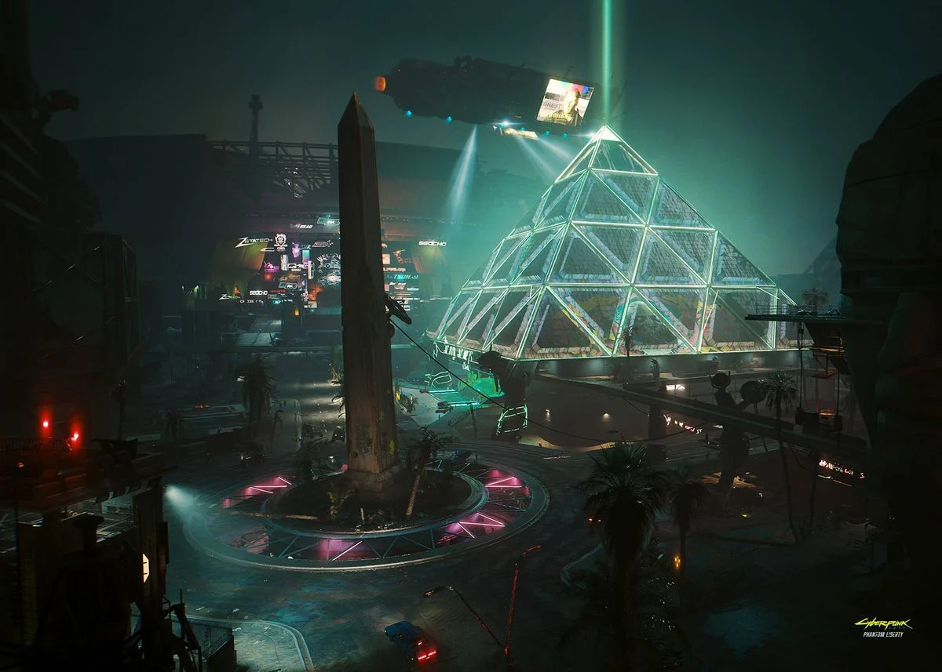
Cyberpunk 2077: Phantom Legacy (2023)
Action RPG
Published by CE Project Red (2023)
Futuristic world with the story set in 2077
Elements of Egyptomania in the so-called „The Heavy Hearts Club” in Night city
Interior is decorated like Luxor casino in Las Vegas

Slide 36
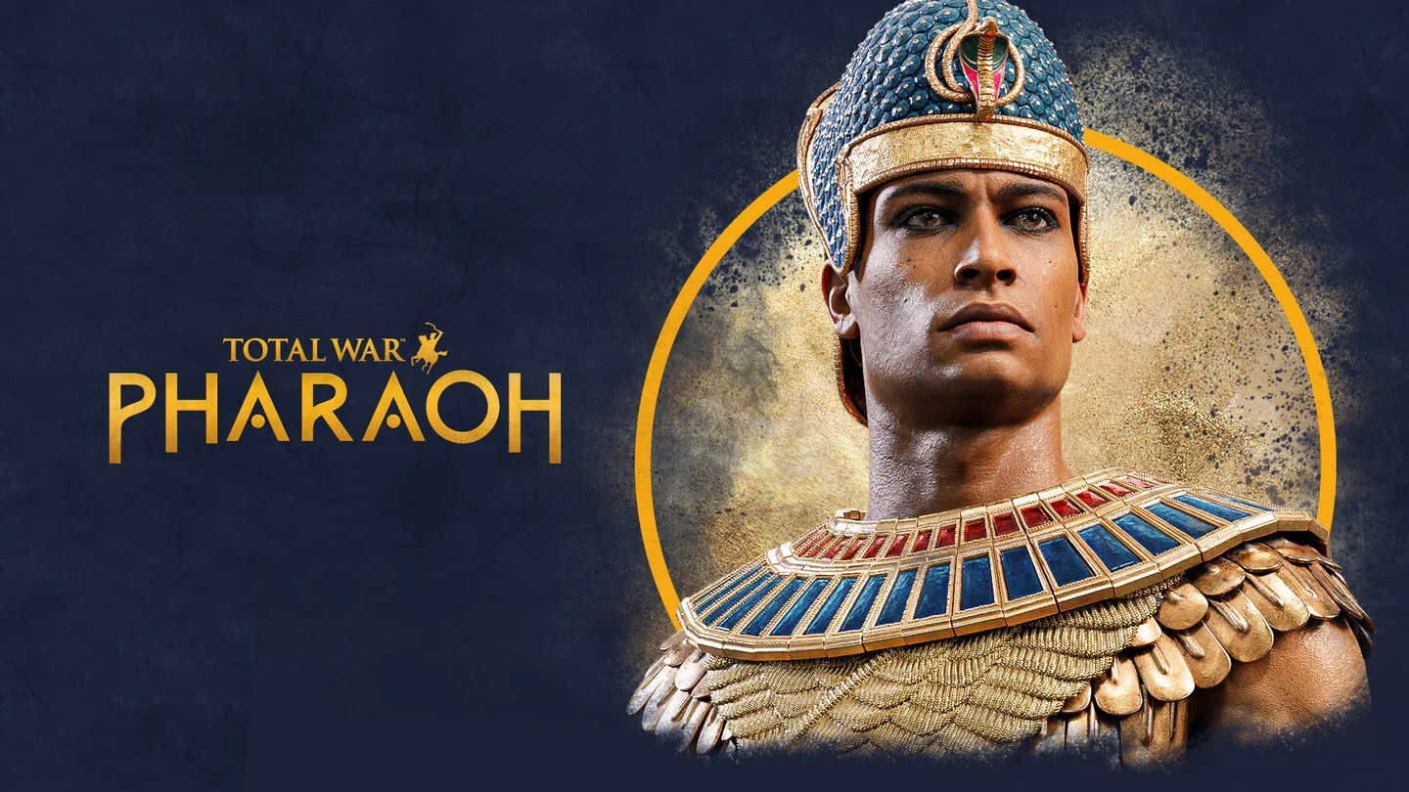
Total War: Pharaoh (2023)
Turn-based strategy
Published by Creative Assembly Sofia/Sega (2023)
Story set in the end of 19th and early 20th dynasties
Young Ramesses III have to raise to throne and fight various Sea peoples
Nicely looking but very complex strategy game
Isn’t very historically accurate game

Slide 37
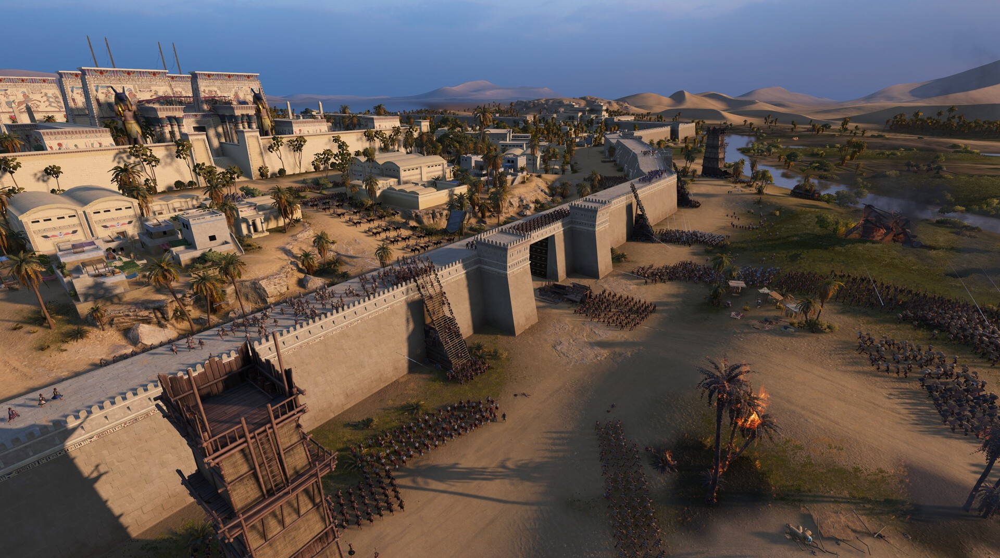

Slide 38

Indiana Jones and the Great Circle (2024)
Action-adventure game
Published by MachineGames/Bethesda Softworks (2024)
Story set in 1937 when Indiana Jones attempts to thwart various groups who are seeking to harness a power connected to the Great Circle
Part of the story is set in Giza where Indy tries to find Idol of Ra while solving many different mysteries and fighting the Nazis

Slide 39


