Slide 1
Book and Library History in Croatian Cultural Teritory
Dr. sc. Lucija Krešić
lkresic@hrstud.hr
Department for Latin Language and Croatian Latinism
Ac. year 2016/2017

Slide 2
Syllabi
Introduction. Literacy begennings on Croatian territory. Croatian literacy on three languages and three scripts.
The oldest Latin manuscripts – Euangeliarium Spalatense and Passionale MR 164.
Old Church Slavonic language. Glagolitic script. Cyrillic script. Old Church Slavonic Canon.
European medieval scriptoria; Dalmatian medieval scriptoria. Codicology, paleography.
Metropolitana Library and the oldest books of Archdiocese in Zagreb.
Gutenberg’s printing press.
Latin incunabula / Glagolitic incunabula in Croatian teritory.

Slide 3
Syllabi
National and University Library in Zagreb
Printing: history and development in Europe / in Croatia
Libraries in Croatia: development. University, public, church, etc. libraries.
National libraries in Europe. Most valuable church libraries in Europe.
Croatian knowledge bases: bibliographies, lexicons and encyclopaedias.
Books and libraries in 21st century: look in the future.

Slide 4
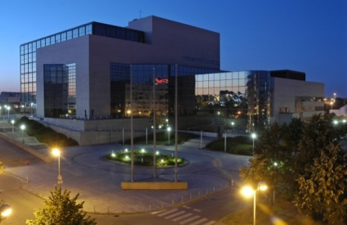
Visit (National and University Library)
http://www.nsk.hr/en/

Slide 5
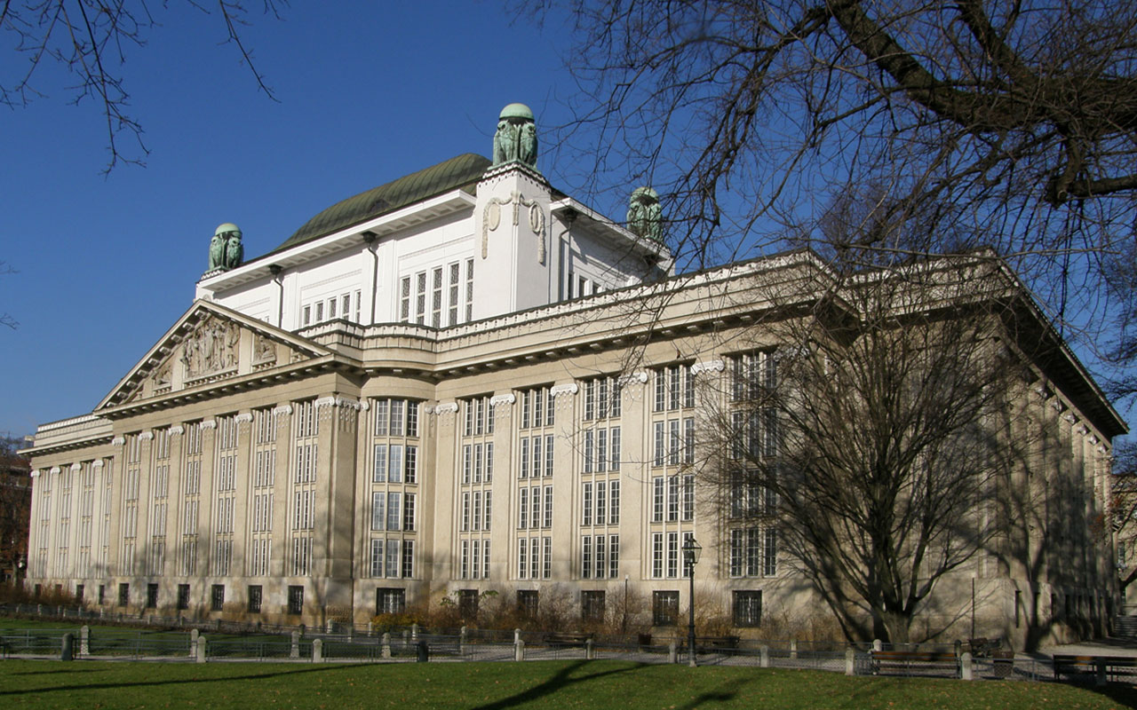
Visit (Metropolitana Library)
http://zagreb.arhiv.hr/en/hr/hda/fs-ovi/metropolitana.htm

Slide 6
Events
Croatian Book Month (from 15 October to 15 November)
http://www.kgz.hr/en/about-us/cultural-actitvities-and-publishing/520
http://www.nsk.hr/en/croatian-book-month-2015/

Slide 7
Events Interliber (International Book and Teaching Appliances Fair) http://www.zv.hr/default.aspx?id=506 https://www.facebook.com/sajaminterliber.zagreb?fref=ts

