Slide 1
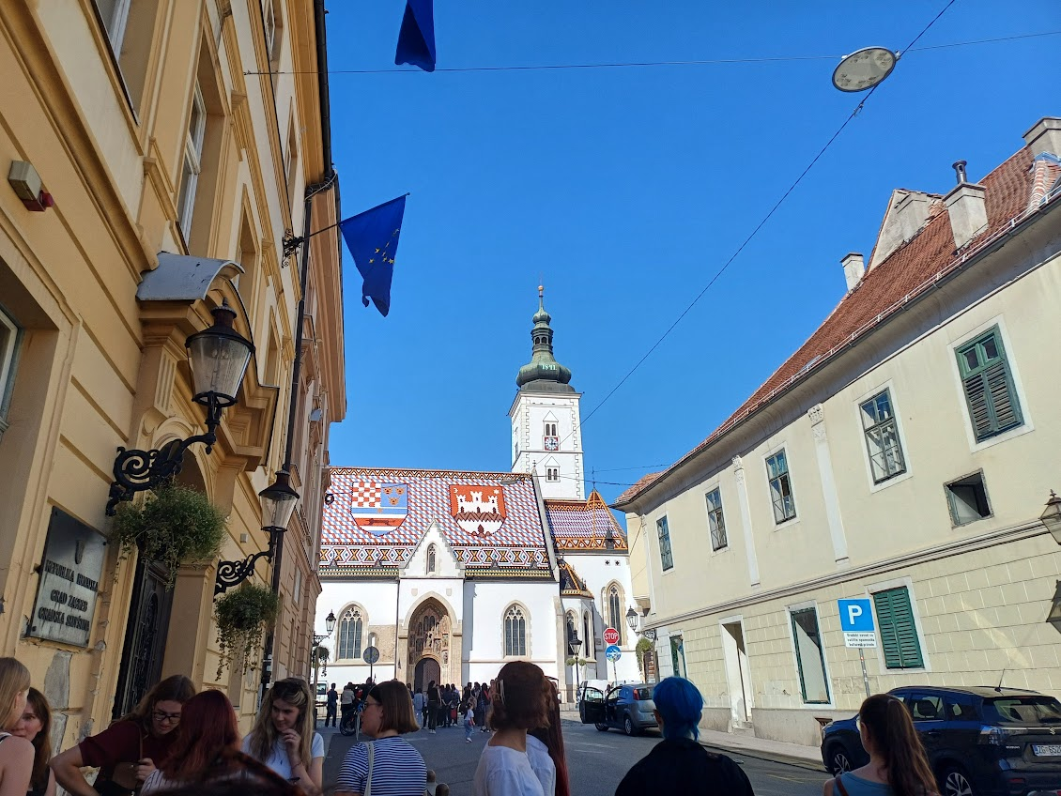
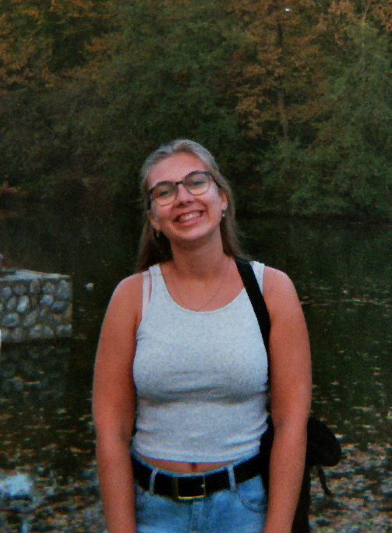
My Stay in Zagreb (Autumn 2024)
My name is Jana Lou and I am from Bern, Switzerland. In 2024 I stayed in Zagreb for one semester.
I studied Croatian at the Faculty of Philosophy and took courses on Croatian politics and culture at the Faculty of Croatian Studies.

Slide 2
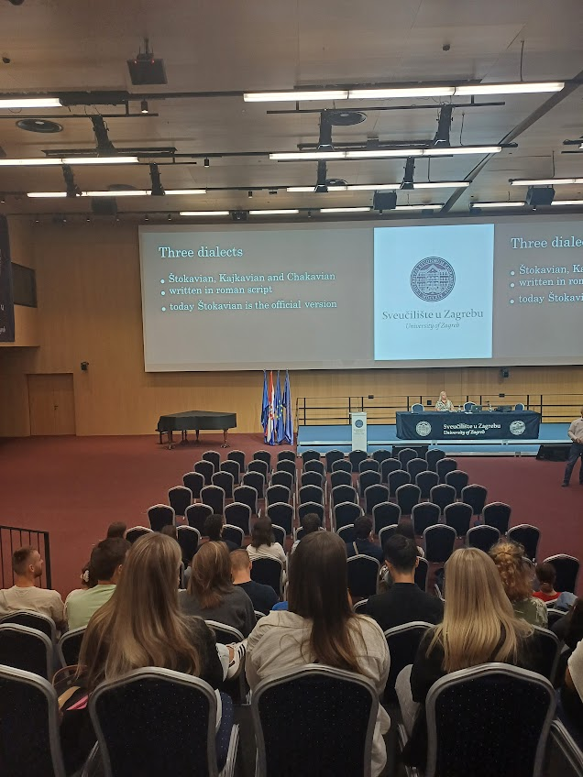
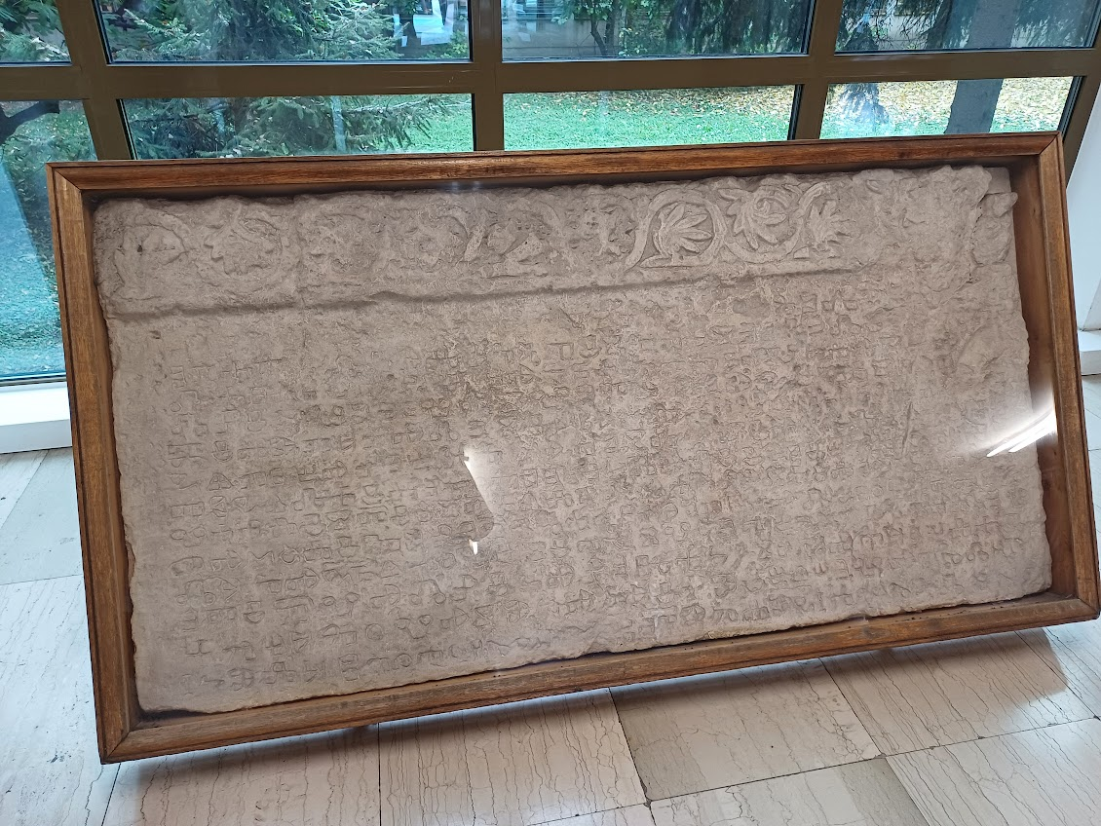
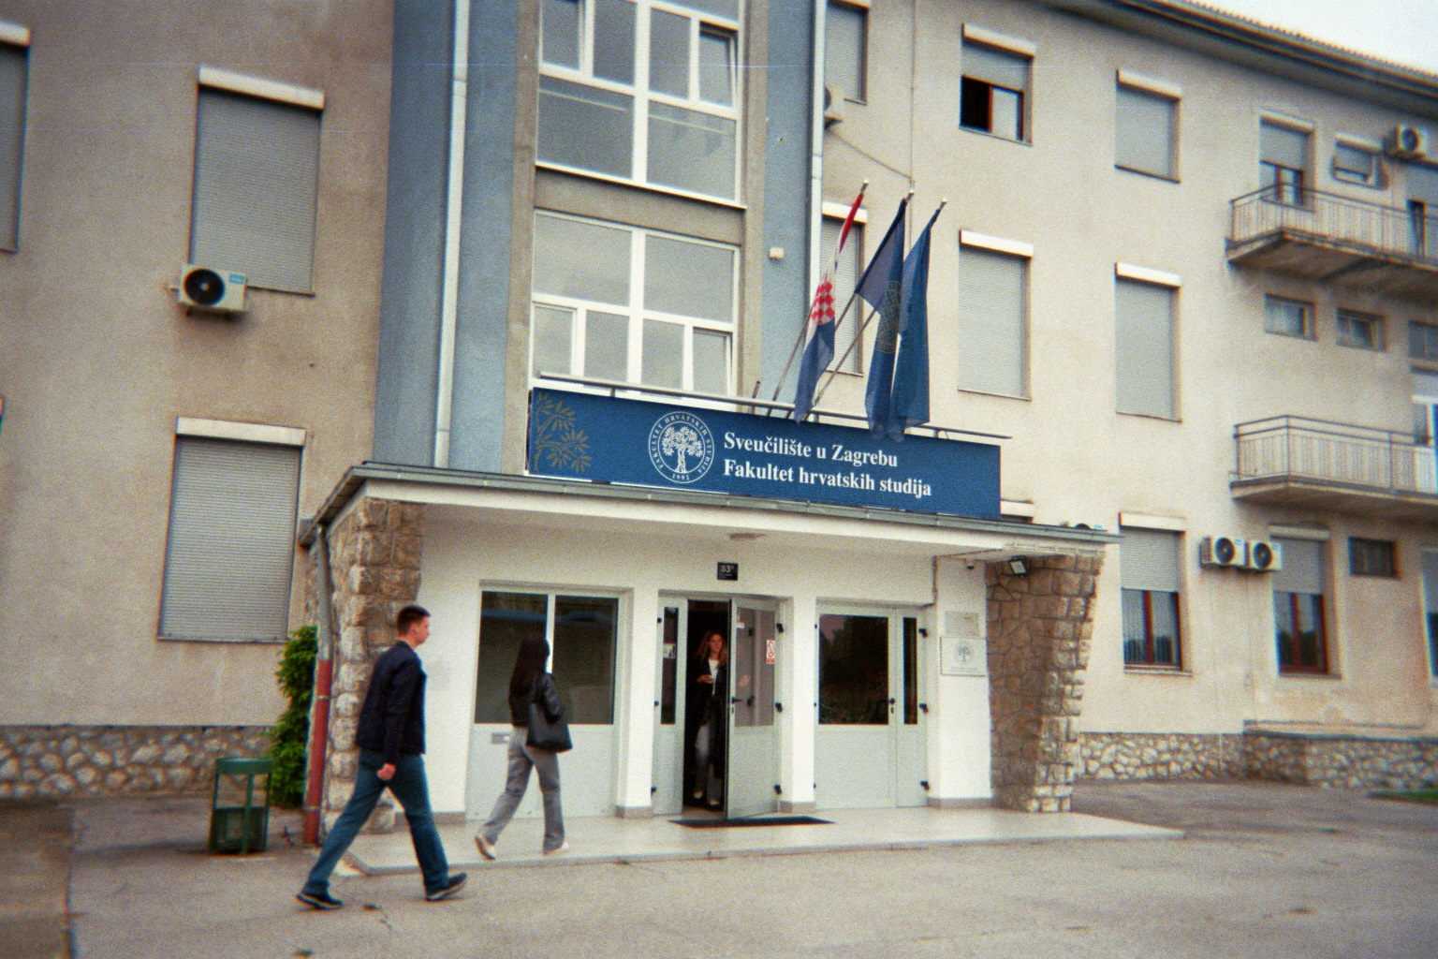
Studying
During my stay I lived at the student dormitory Stjepan Radić
Every day I attended the croatian language course (Level A2/B1) at the Croaticum
I took three classes at the Fakultet hrvatskih studija, two in Croatian and one class on the History of Croatian Culture in english

Slide 3
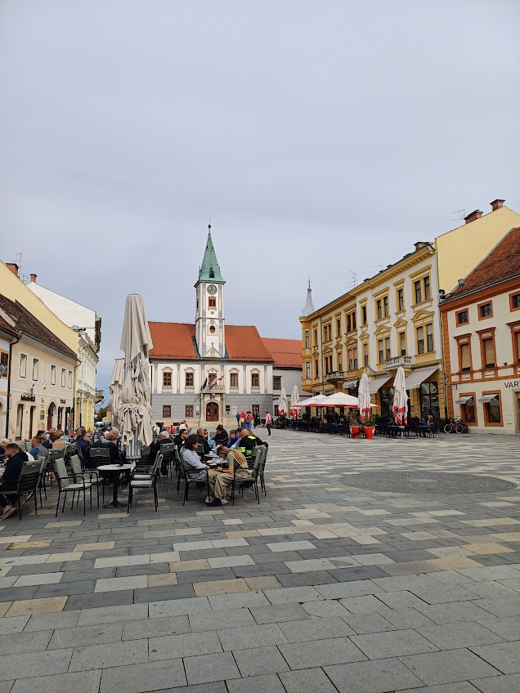
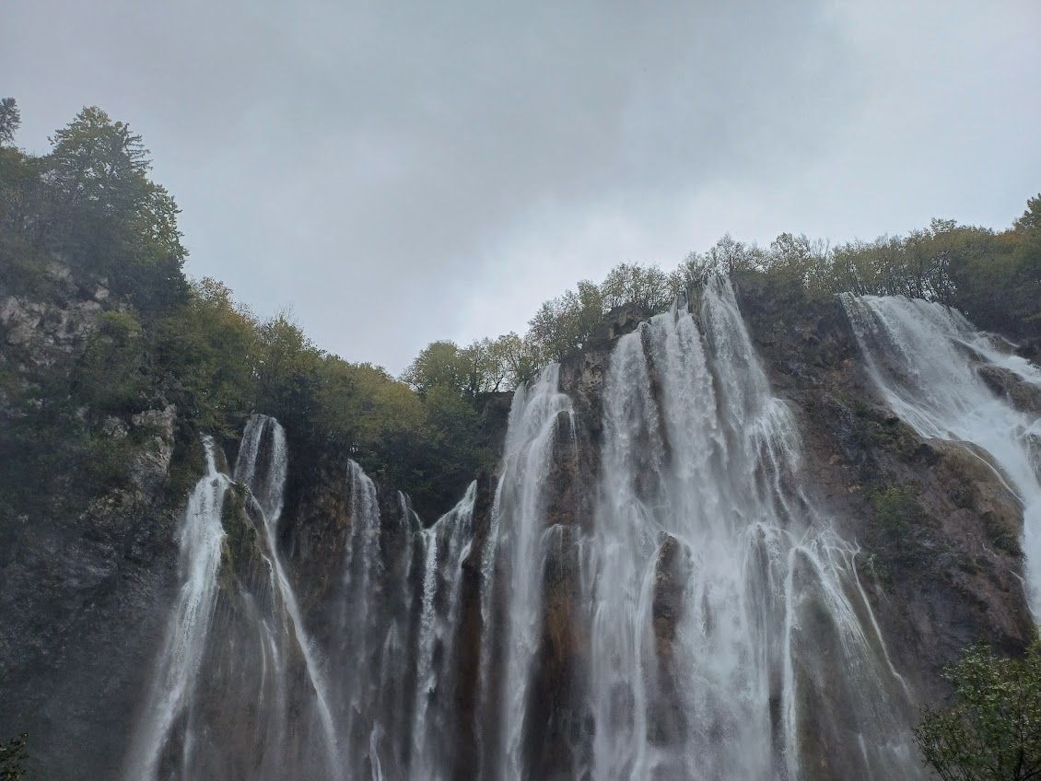
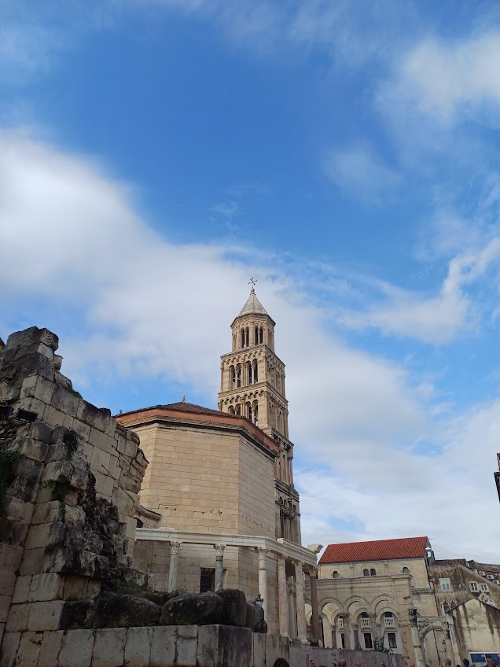
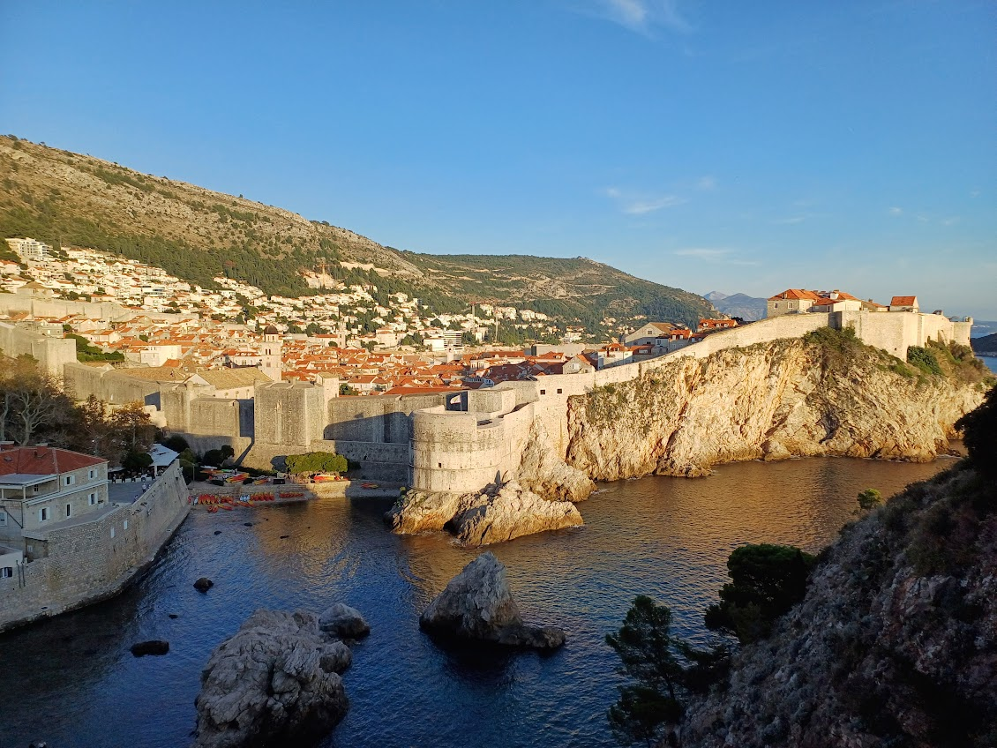
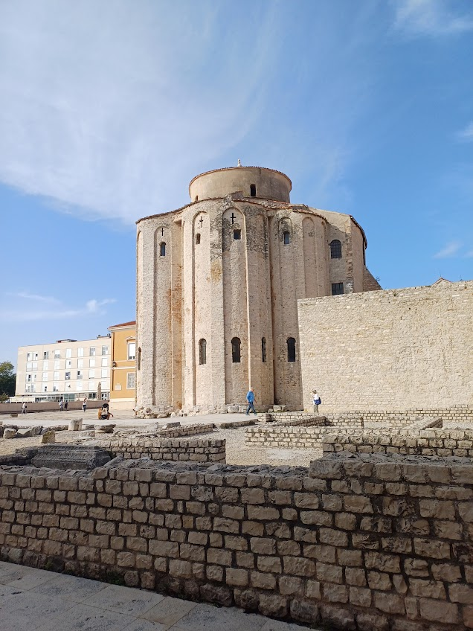
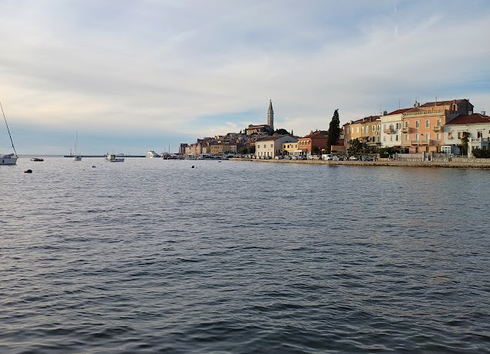
Exploring Croatia
On the weekends I explored many Croatian cities and visited beautiful places
Sometimes I would participate in the trips and events organized by the Erasmus-Student-Network
Plitvička jezera
Varaždin
Zadar
Rovinj
Split
Dubrovnik

Slide 4
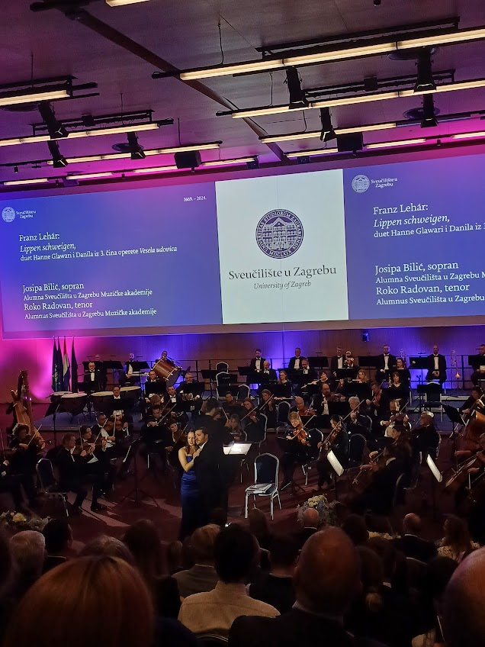
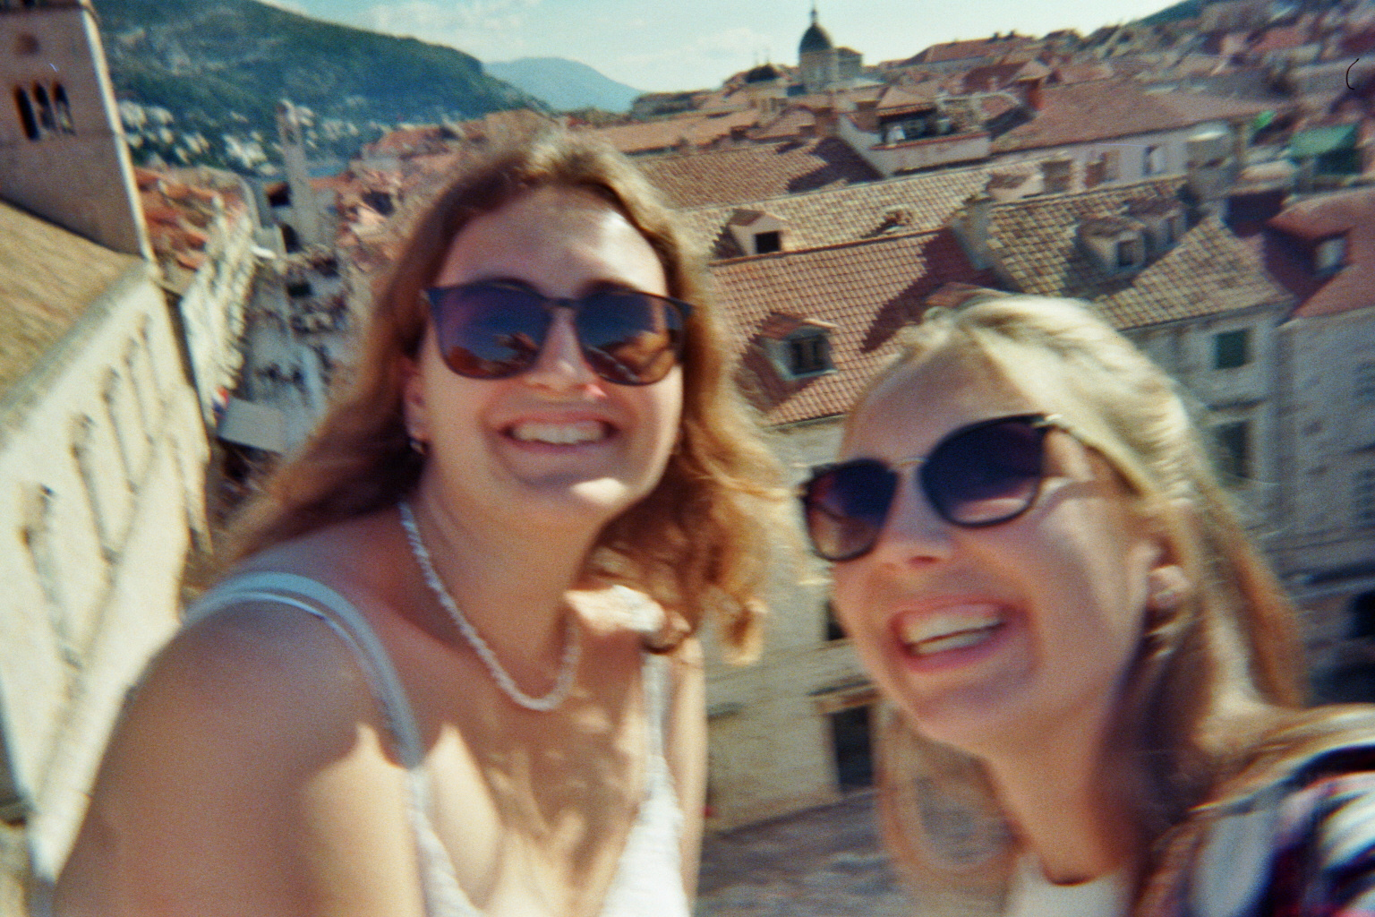
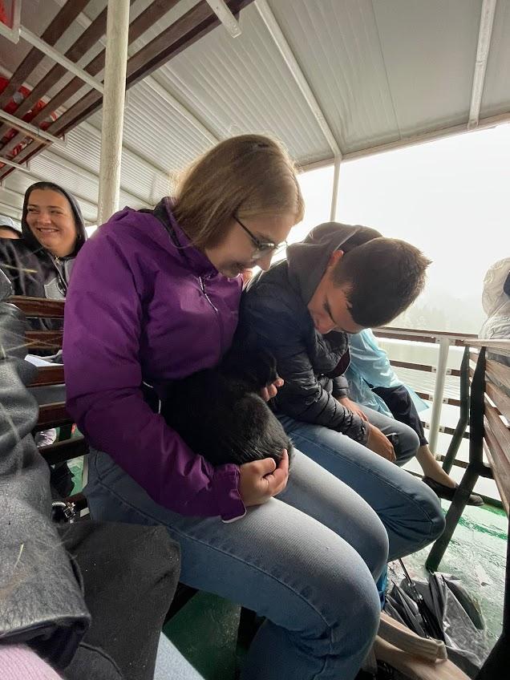
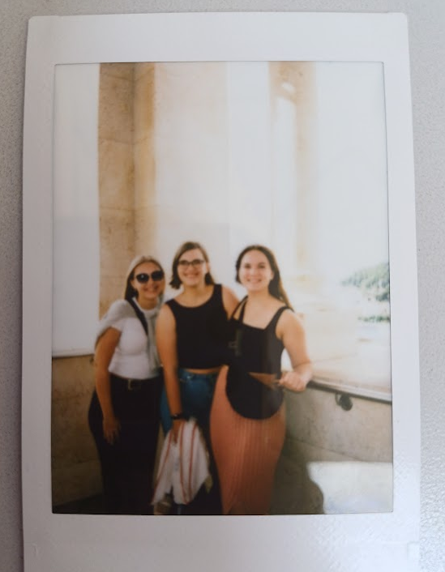
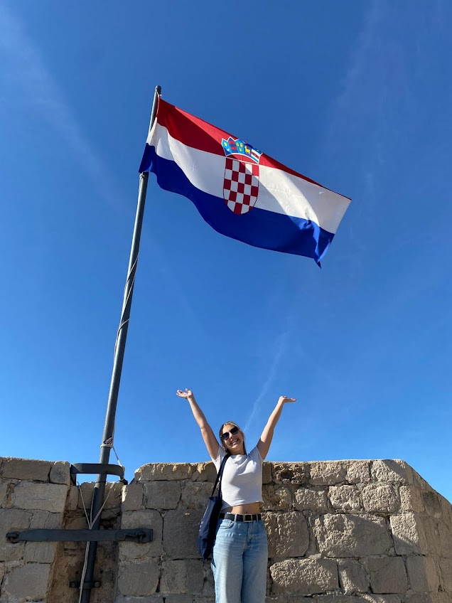
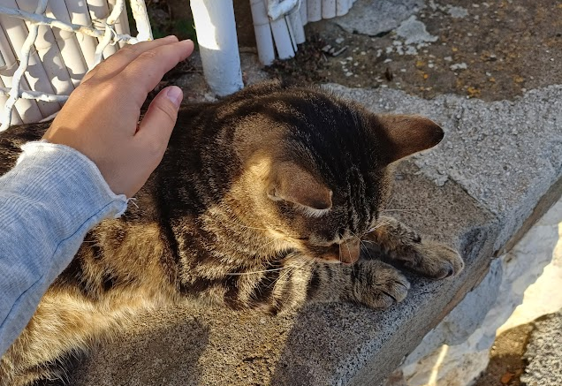
Meeting new people
I met a lot of great people in my semester abroad and lived on my own for the first time
I had a great time and I am still in contact with a few people who became now close friends of mine
..and I met a lot of cute cats

